Slide 1
Work

Slide 2
Work is defined as the transfer of energy from one body to another.
Or more rigorously:
W = ΔE

Slide 3
We can calculate the work done on an object with:
the units of work are Nm or Joules
Note that these are the same units as torque yet their values are used to describe very different quantities.
W = Fd

Slide 4
Although a seemingly simple idea, the concept of work is often misunderstood. Let’s look at a few examples to help clarify.
Example 1 - Work against Gravity
How much work is required to lift a 2.0 kg textbook from the floor to a height of 1.5 m at a constant velocity?
Note:
W = Fd, but what force do we need to exert to lift the book at a constant velocity?
Since the velocity is constant what is the net force acting on the book?

Slide 5
Example 2 - Work on an object
How much work is done on a 4.0 kg medicine ball that is held at a height of 1.8 m for 10 s?
Note:
Is energy being used to hold the ball in this position?
Well, yes…but…
Is work actually being done ON THE BALL?
No. The amount of energy the ball has remains unchanged.

Slide 6
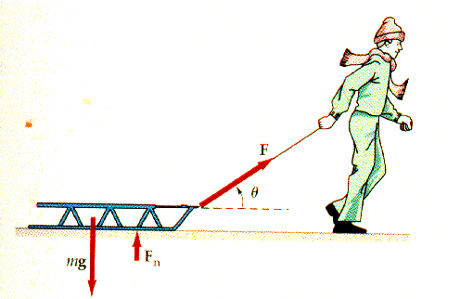
Example 3 – Forces at an angle
The plucky youngster pictured to the right is pulling his sled at a constant velocity of 1.2 m/s. He pulls the 15 kg sled with a force of 35 N at an angle of 40º to the horizontal. How much work does he do in pulling the sled 20 m?
Note:
Draw an FBD showing the forces at work on the sled.
Break F_{boy} into its vertical and horizontal components. Does the vertical component of the force do any work?
Rule: When finding the work done on an object we only consider the component of the force that acts in the direction of displacement.

Slide 7
Example 4 – F_{net} vs. F_{app}
A biology student is pushing a rope 15 m along a level surface. The student pushes the rope with a force of 220 N while the force of friction is 120 N. How much work is the student doing?
Note: To find the amount of work done by the student should we used F_{net} or F_{app}?
Rule: When finding the total work done by a body we always use F_{app}.

Slide 8
Hey wait a minute, if work is the transfer of energy what the heck kind of energy is generated by the force of friction?
Rule: When finding the amount of heat energy is lost due to friction we use:
E_{H} = F_{f}d

Slide 9
Example 5 – To scalar or not to scalar?
Work is the product of a scalar and a vector so (of course) it is a
scalar.
However, work can be positive or negative… but how?
Glad you asked. Imagine that you bring a 1.0 kg basketball from the floor to the top of a 1.0 m table. How much work did you do?

Slide 10
Wow, you’re awesome. Which direction did you exert that force?
Now suppose the ball rolls off the table and falls straight down to the floor. How much work was done on the ball? Be careful: which direction is the force working on the ball now?
Work can be negative when the force doing the work acts in the negative direction.

Slide 11
Another way of thinking of this is to remember that work is a transfer of energy.
When you pick the ball up off the floor you are actually transferring energy to the ball in the form of potential energy.
When the ball falls off the table, it is losing that energy.

