Slide 1
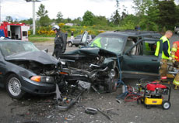
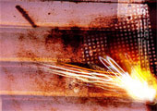
Momentum
A CRASH COURSE IN COLLISIONS & EXPLOSIONS

Slide 2
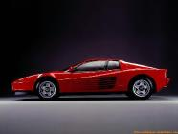
Momentum
Agent
006^{½}
Speeding car
Gun
Mass of bullet = 0.180 kg
v = 600 m/s
Mass = 1500 kg
v = 15 m/s
Agent 006^{1/2} (better know as Johnny Bondage) is in a bit of trouble. He can either be hit by the bullet or by the car.
Which would be worse for him?

Slide 3
Momentum
The combination of velocity and mass is called the quantity called momentum.
p = m x v
The units for momentum are:
kg x m/s
Objects that are not moving have no momentum or objects that have no mass (ie. Light even though travelling at very high speeds) have no momentum.

Slide 4
Momentum
Calculate the momentum of some “common” objects:
Object | Mass | Velocity | Momentum (kgm/s)
Person walking | 75 kg | 1.4 m/s
Pick up truck | 3400 kg | 21 m/s
A jet airliner | 2.2 x 10⁵kg | 225 m/s
Large ocean ship | 1.2 x 10⁷ kg | 7.3 m/s
A large asteroid | 4.5 x 10¹⁴ kg | 7500 m/s
105
71000
5.0 x 10⁷
8.8 x 10⁷
3.4 x 10¹⁸

Slide 5
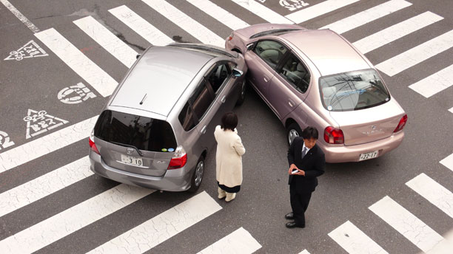
Momentum
Momentum can accurately describe both collisions and explosions.
Explosions are just like collisions, just running backwards!
Collisions and explosions are all about “changing” an objects momentum.

Slide 6
Momentum
Example 1:
A car is travelling at 15 m/s down a road. The driver applies the brakes slowing the car down to 7.0 m/s.
Mass = 1400 kg
v = 15 m/s
Mass = 1400 kg
v = 7.0 m/s
What is the car’s change in momentum?

Slide 7
Momentum
Solution:
Δp = p₂ - p₁
Δp = (mv)₂ - (mv)₁
Δp = (1400 x 7.0) - (1400 x 15)
Δp = 9800 - 21000
Δp = -11000 kg•m/s
Note: Negative sign here. (what does it mean?)

Slide 8
Momentum
But how is the car’s momentum changed?
Answer:
The brakes are applied. The brake pads squeeze the rotor attached to the wheels creating a lot of friction and generating heat. The car has a decrease in speed and therefore has a decrease in momentum .
This requires the use of FORCE. So changing one’s momentum involves the use of Force!

Slide 9
Momentum
Force can only be applied over some time period
When you apply a force over some time period you can change the speed of an object and hence change it’s momentum!!!
Force x time = change in momentum
F x t = Δp

Slide 10
Momentum
The quantity of Force x time is also given the name of “IMPULSE”.
“I need Impulse power now #1!
Force x time = Impulse
Impulse = F x t = Δp = change in Momentum

Slide 11
Momentum
Example Problem #1:
A 0.200 kg ball travelling at 24 m/s is hit with a bat. The bat stays in contact with the ball for 0.23 s and causes the ball to rebound at a speed of 32 m/s.
What force was imparted to the ball?
v = 24 m/s
v = 32 m/s

Slide 12
Momentum
Solution:
F x t = Δp
F x t = p₂ - p₁
F x t = (mv)₂ - (mv)₁
F x o.23 s = (0.200 kg x -32 m/s) - (0.200 kg x 24 m/s)
F x o.23 s = (-6.4 kgm/s) - (4.8 kgm/s)
F x o.23 s = -11.2 kgm/s
Note:
Change in momentum is now bigger the individual original momentums and is negative. Why?

Slide 13
Momentum
-11.2 kgm/s
F =
0.23 s
F =
- 49 N
(1 kgm/s² = 1 N)
Note:
The negative force answer indicates the force was applied in the opposite direction of the ball’s original motion
Do Practice Problems #1- 3 p. 178-179

Slide 14
Momentum
Example Problem #2
A 1800 kg car is travelling at 12m/s east down a road. A force of 2300 N is applied by the cars tires to the road over a time of 4.7 s resulting in the car increasing it’s speed in the same direction. What is the car’s new speed?
Force = 2300 N
t = 4.7 s
m = 1800 kg
v = 12 m/s
m = 1800 kg
v = ?

Slide 15
Momentum
Solution:
F x t = Δp
F x t = p₂ - p₁
F x t = (mv)₂ - (mv)₁
2300 N x 4.7 s = (1800 kg x v) - (1800 kg x 12 m/s)
10810 kgm/s = (1800 kg x v) - (21600 kgm/s)
10810 kgm/s + 21600 kgm/s = (1800 kg x v)

Slide 16
Momentum
32410 kgm/s = 1800 kg x v
32410 kgm/s
= v
1800 kg
18 m/s = v

Slide 17
Conservation of Momentum
The Law of the Conservation of Momentum is one of the most important discoveries in Physics.
It was essentially discovered by Newton (His Third Law of Motion is another way Stating this law).
This law is currently being used in the $16 billion Large Hadron Collider recently completed in Europe.

Slide 18
Conservation of Momentum
Law of Conservation:
The total momentum of the universe is a constant.
or
The total momentum of an isolated system of objects remains constant.

Slide 19
Conservation of Momentum
Or yet another way of saying the same thing:
Momentum before = Momentum after
Momentum total before = Momentum total after
Total p_{before} = Total p_{after}
p_{1before} + p_{2before} = p_{1after} + p_{2after}

Slide 20
Conservation of Momentum
Example 1:
A 4.0 kg toy truck travelling at 2.0 m/s due east collides with a stationary 2.4 kg toy car. After the collision the two vehicles stick together. What is the initial velocity of the stuck vehicles after the collision?
v = 0 m/s
v = 2.0 m/s
m = 4.0 kg
m = 2.4 kg
v = ?
m = 2.4 kg + 4.0 kg

Slide 21
Conservation of Momentum
Solution:
p_{b} = p_{a}
p_{tb} + p_{cb} = p_{ta} + p_{ca}
(4.0 kg x 2.0 m/s) + 0 kgm/s = (4.0 + 2.4 kg)x v
8.0 kgm/s = (6.4 kg) x v
(8.0 kgm/s) = v
(6.4 kg)
1.3 m/s = v

Slide 22
Conservation of Momentum
Example 2:
A 1.2 kg green puck travelling at 2.0 m/s due east collides with a 2.4 kg red puck travelling at 4.5 m/s due west. After the collision the red puck travels due west at 2.5 m/s. What is the velocity of the green puck after the collision?
m = 1.2 kg
v = 4.5 m/s
v = 2.0 m/s
m = 2.4 kg
v = ?
v = 2.5 m/s

Slide 23
Conservation of Momentum
Solution:
p_{b} = p_{a}
p_{gb} + p_{rb} = p_{ga} + p_{ra}
Why the negative sign?
(1.2 kg x 2.0 m/s) + ( 2.4 kg x -4.5 m/s) = (1.2 kg x v) + (2.4 kg x -2.5 m/s)
2.4 kgm/s + -10.8 kgm/s = (1.2 kg x v) +(-6.0 kgm/s)
(-8.4 kgm/s + 6.0 kgm/s) = 1.2 kg x v
-2.4 kgm/s = v
1.2 kg
Why the negative sign?
-2.0 m/s = v

Slide 24
Conservation of Momentum
Example 3:
At what velocity will a 0.025 kg fly have to travel to stop a 65000 kg truck initially travelling at 19 m/s due east?
v = 19 m/s
v = ?
m = 65000 kg
m = 0.025 kg
After:
v = o m/s

Slide 25
Conservation of Momentum
Solution:
p_{b} = p_{a}
Why no momentum after?
p_{tb} + p_{fb} = 0
(65000 kg x 19 m/s) + ( 0.025 kg x v) = 0
1235000 kgm/s + (0.025 kg x v) = 0
1235000 kgm/s = - 0.025 kg x v
Why the negative sign?
1235000 kgm/s = v
- 0.025 kg
Why the negative sign?
-4.9 x 10⁷ m/s = v
Talk about Superfly!!

Slide 26
Conservation of Momentum
Example 4:
A 3.5 kg truck is made up of a 1.1 kg tractor and a 2.4 kg trailer. This truck is travelling along at 2.5 m/s when a small firecracker explodes separating the tractor from the trailer. The tractor travels at 4.0 m/s after the small explosion. What is the initial velocity of the trailer after the explosion?
v = 2.5 m/s
m = 1.1 kg
m = 2.4 kg
v = 4.0 m/s
v = ?
m = 1.1 kg
m = 2.4 kg

Slide 27
Conservation of Momentum
Solution:
p_{b} = p_{a}
p_{1b} = p_{1a} + p_{2a}
(3.5 kg x 2.5 m/s) = (1.1 kg x 4.0 m/s) + (2.4 kg x v)
8.75 kgm/s = (4.4 kgm/s) + (2.4 kg x v)
8.75 kgm/s - 4.4 kgm/s= 2.4 kg x v
4.35 kgm/s = v
2.4kg
1.8 m/s = v
In the same direction!

Slide 28
Conservation of Momentum
Practice Problems #5-7 p. 185
Practice Problems #9 -11 p. 188-189
Go on to the Momentum Worksheet

Slide 29
Momentum

