Slide 1
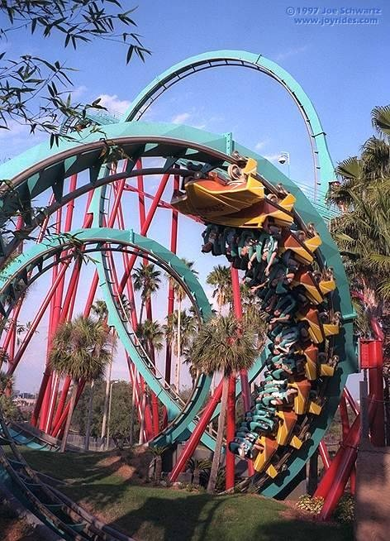
Centripetal Acceleration

Slide 2
This unit we will investigate the special case of kinematics and dynamics of objects in uniform circular motion – traveling in a circle at a constant speed.
First let’s consider a mass on a string being twirled overhead at a constant speed.
Let’s determine the speed of the object.
Remember that speed is defined as:

Slide 3
We define the period of motion (T) as the time it takes to complete one rotation. How far does it travel in one rotation?
We can find the circumference of the circular path by:
Therefore the speed of an object in uniform circular motion is:

Slide 4
Ok so we’ve figured out its speed, but is the mass accelerating?
Remember that the mass is traveling at a constant speed. However, acceleration is defined as:
So how does the velocity of the mass change with respect to time?

Slide 5
Notice that the direction of the velocity at any time is tangent to its path.

Slide 6
So even though it may be traveling at a constant speed any body traveling in a circular path is accelerating because the direction of its velocity is always changing.
The acceleration of an object in uniform circular motion is:
a_{c} = v² = 4π²r
r T²

Slide 7
Let’s do a quick derivation of this formula:

Slide 8
It is important to note from the above derivation that the direction of the change in velocity is always towards the centre of the circle.
Therefore the acceleration of an object in circular motion is always towards the center of the circle.
This is the definition of centripetal, which means center-seeking.

Slide 9
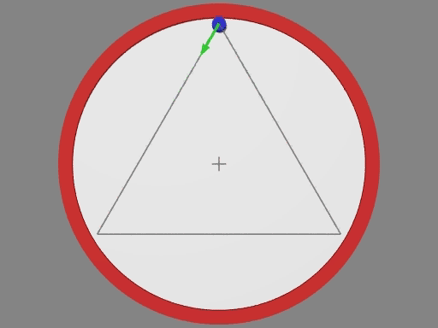
We can also derive the formula by limits...

Slide 10
Whenever an object is accelerated there must be a net force acting on it.
This force is known as centripetal force, F_{c}.
This is not a new force, it is simply the net force that accelerates an object towards the center of its circular path.

Slide 11
Examples:
1. A mass is twirled in a circle at the end of a string, the centripetal force is provided by…
tension
. When a car rounds a corner on a highway, the centripetal force is provided by…
friction
. When the Moon circles the Earth, the centripetal force is provided by…
gravity

Slide 12
Newton’s Second Law we can help us to determine a formula for centripetal force:

Slide 13
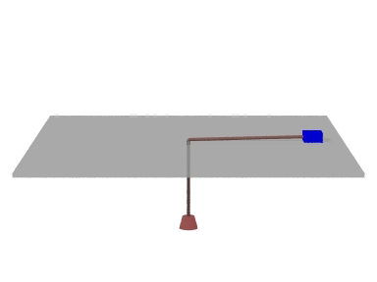
Example:
A 0.50 kg mass sits on a frictionless table and is attached to hanging weight. The 0.50 kg mass is whirled in a circle of radius 0.20 m at 2.3 m/s. Calculate the centripetal force acting on the mass.
Calculate the mass of the hanging weight.

Slide 14
Example:
A car traveling at 14 m/s goes around an unbanked curve in the road that has a radius of 96 m. What is its centripetal acceleration?

Slide 15
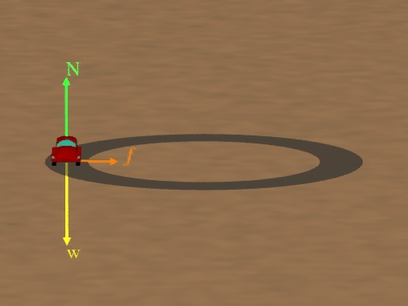
What is the minimum coefficient of friction between the road and the car’s tires in the last question?

Slide 16
Example:
A plane makes a complete circle with a radius of 3622 m in 2.10 min. What is the speed of the plane?

Slide 17
One last note on a little thing called centrifugal force. While centripetal means center-seeking centrifugal means center- fleeing.
Centrifugal force is actually an apparent force - it does not exist. It is simply the apparent force that causes a rotating object to move in a straight line.
However, Newton’s First Law tells us that we do not need a force to keep an object moving in a straight line, you only need a force to deflect an object from moving in a straight line.
In reality what we seem to feel as centrifugal force is really…

Slide 18
Example:
When riding in the backseat of a car that is turning a corner, you slide across the seat, seeming to accelerate outwards, away from the center of the turning circle.
In reality your forward inertia you had before the car started to turn makes you want to continue in a straight line.
It is not until you slide into the side door and it exerts a centripetal force (normal force in this case) that accelerates you towards the center of the turn.

