Slide 1
Forces

Slide 2
Force: Any push or pull.
The units of force are Newtons (N)
There are four fundamental forces that make up all of the forces in the universe:
1) Gravitational Force
2) Electromagnetic force
3) Strong Nuclear Force
4) Weak Nuclear Force

Slide 3
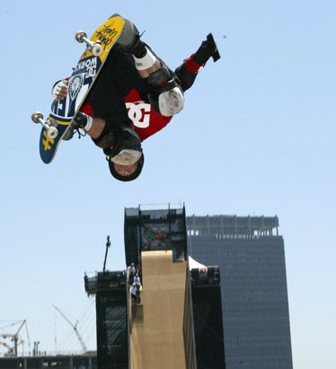
Force of Gravity

Slide 4
Force of Gravity: Any two objects will feel a force of attraction that depends on their masses and distance apart.
Mass (kg): The amount of matter in an object.
Weight (N): The amount of gravitational force felt by an object.
Mass is constant throughout the universe whereas weight changes depending on where you are.

Slide 5
The formula for force of gravity is:
F_{g} = mg
Where:
m = mass (kg)
g = acceleration due to gravity (m/s²)
= gravitational field strength

Slide 6
g varies depending on the size of the planet and distance to the object
For Example:
On Earth at sea level g = 9.80 m/s²
On the moon’s surface g = 1.60 m/s²
On Jupiter g = 24.5 m/s²
The Sun g = 274 m/s²
Determine your weight (in Newtons) on Earth, the moon and Jupiter.

