Slide 1
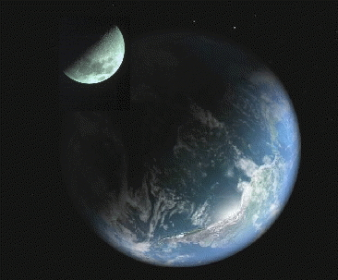
Force of Gravity
The Law of Universal Gravitation

Slide 2
Gravity attracts any two objects depending on their masses and their distance apart.
Newton’s Universal Law of Gravitation states:
F_{g} = GMm
r²
Where: G = Universal Gravitational Constant
= 6.67 x 10⁻¹¹ Nm²/kg²
M = mass of first object
m = mass of second object
r = distance between their centers of mass

Slide 3
Ex 1: What is the force of gravity exerted on a 70.0 kg astronaut that is standing on Earth’s surface?
Radius of Earth = 6.38 x 10⁶ m
Mass of Earth = 5.98 x 10 ²⁴ kg

Slide 4
Ex 2: What is the force of gravity acting on a 70.0 kg astronaut who is at an altitude of 6.38 x 10⁶ m?
Distance above the Earth’s surface

Slide 5
Ex 3: Two physics lab partners sit side by side. One has a mass of 55 kg and the other a mass of 65 kg. If they sit 50.0 cm apart, what is the irresistible force of attraction between them?

Slide 6
A typical problem type… An astronaut weighs 800 N on Planet X. How much would she weigh if she was at an altitude equal to the radius of Planet X?

Slide 7
A spaceship orbits a planet at radius, r and weighs 10 000N. How much would it weigh if it orbits a planet twice as massive at half the radius?

