Slide 1
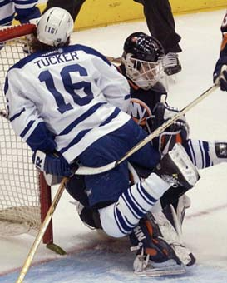
Momentum

Slide 2
Any moving object has momentum, which depends on its:
Velocity
Mass
Where: ρ = momentum
m = mass
v = velocity
ρ = mv

Slide 3
Momentum is a vector quantity, meaning it has both magnitude AND direction.
- Right and Up are +
- Left and Down are -
The units are kgm/s
The units can also be written as N·s

Slide 4
Ex:
Calculate the momentum of a 6.2 kg pumpkin traveling at a velocity of 5.0 m/s west.

Slide 5
Ex:
A baseball of mass 0.14 kg is moving at 35.0 m/s.
a. Find the momentum of the baseball.
b. Find the velocity at which a bowling ball, mass 7.6 kg, would have the same momentum as the baseball.

Slide 6
Remember:
Change = Final - Initial
Ex:
A 0.50 kg water balloon is thrown against a wall at 32 m/s coming to a stop. What was its change in momentum?
b) A 0.50 kg bouncy ball is thrown at 32 m/s, bouncing back with the same speed. How does its change in momentum compare to that of the water balloon?

