Slide 1
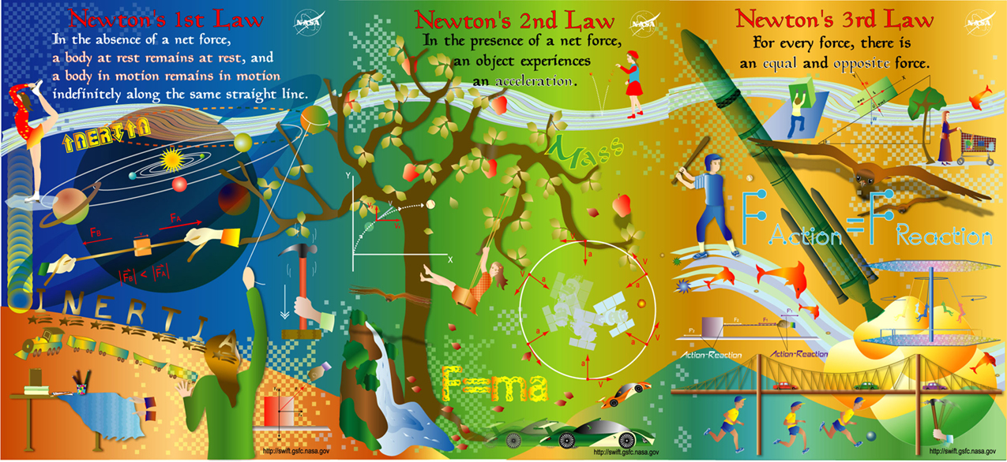
Newton’s Laws

Slide 2
In 1665 Sir Isaac Newton formulated three laws that dictate the motion of objects. These three laws are universal and apply to all forces in the universe.
Newton’s 1st Law:
An object in motion will stay in motion and an object at rest will stay at rest unless a force is applied to it.
Examples:

Slide 3
Newton’s 2nd Law:
In the presence of a net force an object experiences an acceleration.
As a formula:
F_{net} = ma
Examples:

Slide 4
Newton’s 3rd Law:
For every action force there is an equal and opposite reaction force.
As a formula:
F_{action} = -F_{reaction}
Examples:

Slide 5
Free Body Diagrams: (Draw one for EVERY force question)
Represent the object in question as a square.
Represent all forces working on the object as arrows.
The arrows are vectors, so their direction is critical
Start in the center and draw outwards
Remember that the size of the arrow represents the magnitude of the force.

Slide 6
Examples: Draw FBDs for each situation
1. A textbook sits motionless on a table.

Slide 7
2. A coconut falls from a tree (no air friction).

Slide 8
3. A puck slides along frictionless ice.

Slide 9
4. A dragster accelerates from rest.

Slide 10
5. A car drives at a constant velocity.

Slide 11
6. A block of wood slides down an incline.

Slide 12
1. A student pulls straight upwards with a force of 650 N on their 15 kg backpack. What is the backpack’s acceleration?

Slide 13
2. A 1200kg car accelerates at 5.85 m/s². If the force of friction acting on the car is 2800 N, how much force does the engine exert?

Slide 14
AHA! Trickery!
Just when you though you were done with kinematics, they sneak back in. You will be expected to use kinematics to solve for acceleration to use in force problems and vice versa.
Ex: A 2.10 kg curling rock is hurled down ice at 6.5 m/s. It comes to a stop in 12.0 s. What is force of friction between the ice and the rock?
Note: there is only friction acting on the rock, therefore
F_{net} = F_{f}

Slide 15
Zounds…More Trickery!
Remember that when determining the forces working on an object we need to consider their directions. If a force is working in the direction of acceleration we need to break it down into components.
Ex: A boy pulls his 8.0 kg toboggan by a rope that angles 32º above the horizontal. If his 36.0 kg sister sits on the toboggan, how much force does he need to exert to accelerate them at 2.25 m/s²? (Assume no friction)

