Slide 1
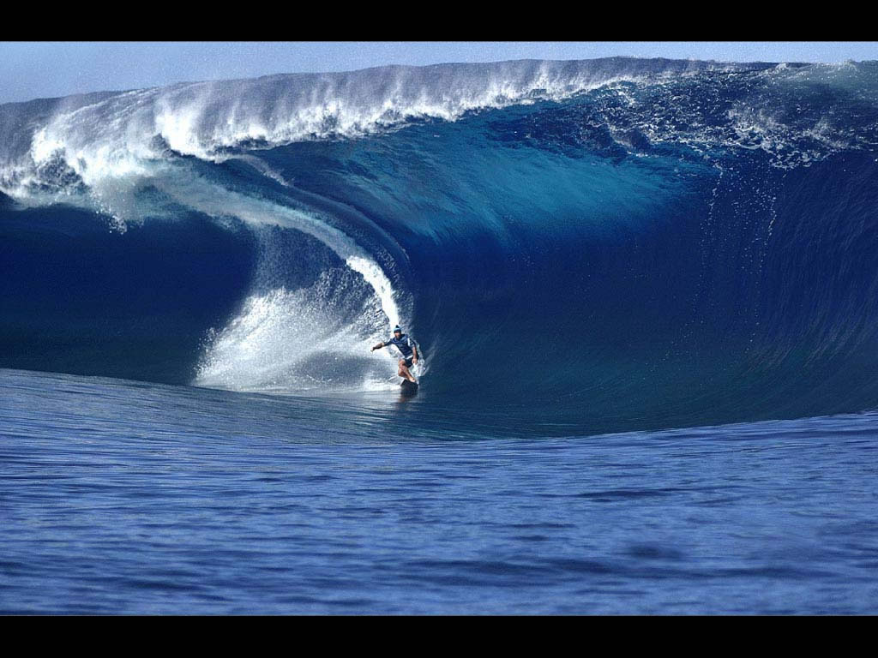
Waves

Slide 2
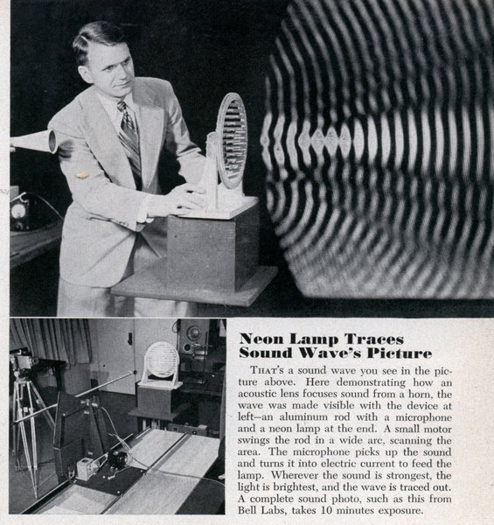
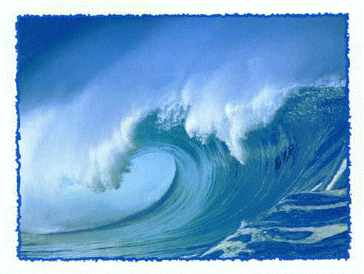
A wave is a disturbance (or vibration) that carries energy from one point to another, but does not carry matter.

Slide 3
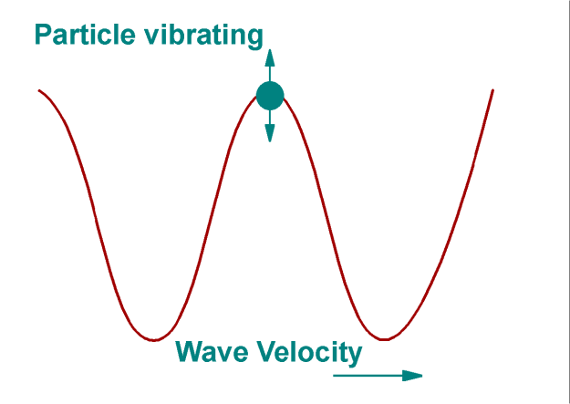
There are 3 types of mechanical waves:
1. Transverse: particles of the medium vibrate perpendicular to the direction of the wave
(ex. light, guitar strings)

Slide 4
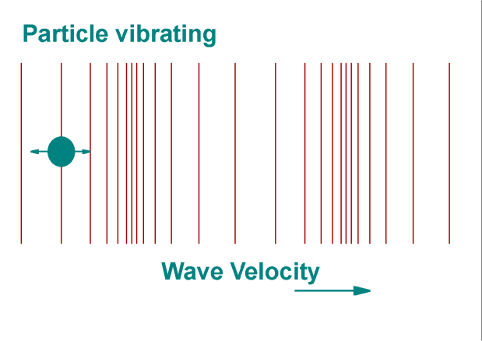
2. Longitudinal: particles of the medium move parallel to the direction of the wave
(ex. sound)

Slide 5
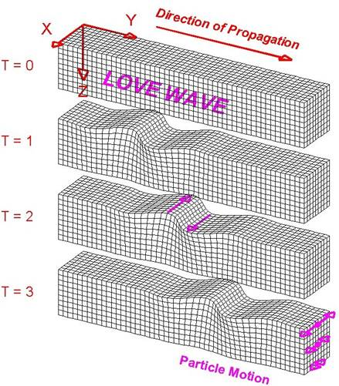
3. Surface: A mixture of transverse and longitudinal
(ex. ocean waves)
Surface waves are much more complicated
and are not covered in this course!!!

Slide 6
Medium: What the wave travels through
Crest: High point on a wave
Trough: Low point on a wave
Amplitude (A): Max displacement from rest
Wavelength (λ = lambda): distance between two crests (or troughs)

Slide 7
Period and Frequency
Period (T): Time it takes for one complete cycle, measured in seconds
Frequency (f): Number of complete cycles per second, measured in Hertz (Hz)
Frequency and Period are reciprocal, that is:
f = 1 T

Slide 8
Ex:
Playing middle C on a piano produces a sound with a frequency of 256 Hz. What is the period of the sound wave?

Slide 9
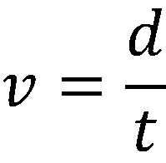
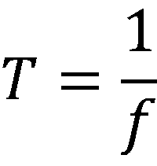
Remember that speed is:
If we look a single wave then:
the distance (d) is one wavelength (λ)
the time (t) is the period ( )

Slide 10
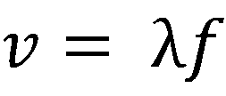
This gives us the Universal Wave Equation:
Where:
v = wave speed (m/s)
λ = wavelength (m)
f = frequency (Hz)

Slide 11
Example:
An air horn sounds at a frequency of 220 Hz. If the speed of sound in air is 330 m/s what is the wavelength of the sound wave?

Slide 12
Example:
The distance between successive crests in a series of water waves is 4.0 m, and the crests travel 8.6 m in 5.0 s.
Calculate the frequency of a block of wood bobbing up and down on these water waves.

