Slide 1
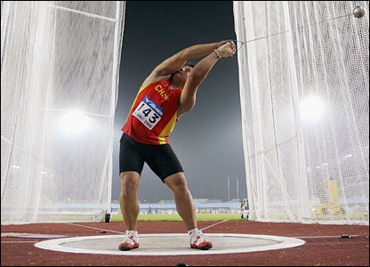
More Centripetal Force Problems

Slide 2
We have already seen the forces acting on a mass moving in a horizontal circle, now let’s see how this differs from a mass moving in a vertical circle.
Draw the forces acting on a mass on a string being spun in a vertical circle at the top and bottom of its path.
As with any object moving in a circle there is a net force acting on it.

Slide 3
Notice that at the top of its arc the centripetal force (or net force) is:
Also at the bottom of the arc the centripetal force is:

Slide 4
Example:
A 1.7 kg object is swung from the end of a 0.60 m string in a vertical circle. If the time of one revolution is 1.1 s, what is the tension in the string:
at the top?
b) at the bottom?

Slide 5
Now suppose the mass is spun with just enough speed to keep it moving in a circular path. What is the tension in the string at the top?
We say that the mass at the peak of the arc is weightless, because the net force working on it is only gravity. This is the same as an object in total free fall.

Slide 6
Example:
An object is swung in a vertical circle with a radius of 0.75 m. What is the minimum speed of the object at the top of the motion for the object to remain in circular motion?

Slide 7
Notice that the velocity of the object is constant it depends only on the radius of the circle and the period of rotation.
For the special case of finding the minimum speed of an object at the top of its circular arc we can use the equation:
Fc = Fg

Slide 8
Banked Curves:
When cars travel at high speeds on highways, they do not rely solely on friction to keep the cars from sliding off the road. A greater centripetal force can exist if the turn is banked.
Consider a car traveling at a constant speed around a frictionless banked corner.

Slide 9
On a frictionless corner only F_{g} and F_{N} act on the car.
Note that in this case F_{N} is larger F_{g} because it both:
(1) Balances F_{g}
(2) Provides F_{c} towards the center of the circle
The sum of F_{N} and F_{g} must equal F_{c} .
F_{N}
F_{g}
F_{c}

Slide 10
Example
Calculate the angle at which a frictionless curve must be banked if a car is to round it safely at a speed of 22 m/s if its radius is 475 m.

Slide 11
Example
A 0.25 kg toy plane is attached to a string so that it flies in a horizontal circle with a radius of 0.80 m. The string makes a 28º angle to the vertical. What is its period of rotation?
28º

