Slide 1
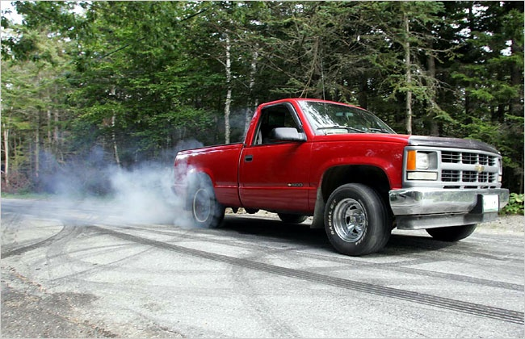
Force of Friction

Slide 2
Friction is created whenever two surfaces try to move past one another. On the microscopic level, irregularities in each surface impede motion, therefore the smoother the surface the less friction.
Force of friction (F_{f}) is given by the equation
Where: F_{N} = the normal (supporting) force
μ = coefficient of friction
= greater for rougher surfaces
F_{f} = µF_{N}

Slide 3
There are 2 types of friction:
Static Friction: friction on a motionless body
Kinetic Friction: friction on a moving body
Note that the irregularities in a static object will tend to “dig in” more and generally:
Friction_{static} > Friction_{kinetic}
μ_{s} > μ_{k}

Slide 4
Ex 1:
A 3.75 kg block is pushed along a tabletop with a force of 45.0N. The coefficient of friction is 0.65.
a) Find the force of friction.
b) Find its acceleration.

Slide 5
Ex 2:
A 0.200 kg puck is pushed along a sheet of ice with a force of 0.240 N. If it moves at a constant velocity, find the coefficient of friction

Slide 6
Ex 3:
A 1.12 kg textbook is pushed horizontally against a wall with a coefficient of friction of 0.465. What is the least amount of force required to keep the book from slipping?

