Slide 1
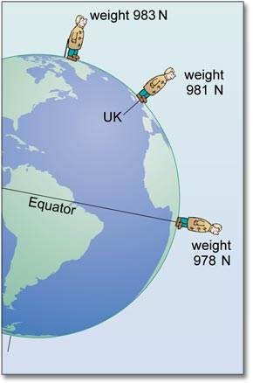
Gravitational Field Strength

Slide 2
To help explain how two bodies that are not in contact can exert a force on one another (i.e. gravitational, magnetic or electrostatic) we use the concept of fields.
Fields are spheres of influence. They are invisible and intangible; they simply demonstrate how strong a characteristic is at a certain distance.

Slide 3
Consider a campfire. We can think of it as having a heat field.
The closer we get to the fire, the stronger the field becomes.
Likewise, the larger the fire is, the further away we will notice its field.

Slide 4
Gravitational fields are defined as:
g = F_{grav}
m
Notice that its units are in N/kg or m/s²
g = GM
r²

Slide 5
Ex 1
The Earth is not actually a perfect sphere. Just like a spinning basketball, it is an oblate spheroid … or kinda bulgy in the middle.
Calculate the acceleration due to gravity:
At the North Pole (r = 6.370x10⁶ m)
At the Equator (r = 6.386x10⁶ m)

Slide 6
Ex 2
The moon is 385 000 km away from the Earth’s surface. What is the Earth’s gravitational field strength at this distance?

