Slide 1
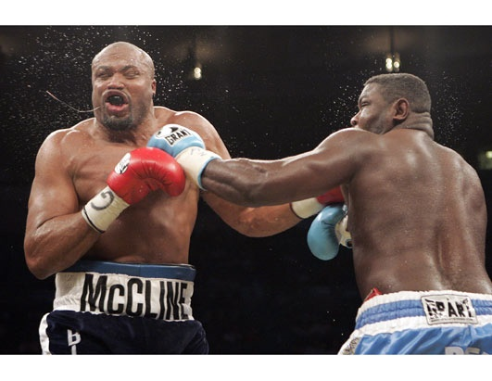
Impulse

Slide 2
Fun Fact:
How long does it take a fully loaded supertanker traveling at a normal speed of 30 km/h to come to a complete stop?
2 seconds
20 seconds
2 minutes
20minutes
Impulse: The change in momentum (Δ ρ).
We define the change in momentum from Newton’s 2nd Law:
F_{net} = ma
F_{net} = m Δv
t
That takes almost 5 km!!!
Δ ρ = mΔv = F_{net}t

Slide 3
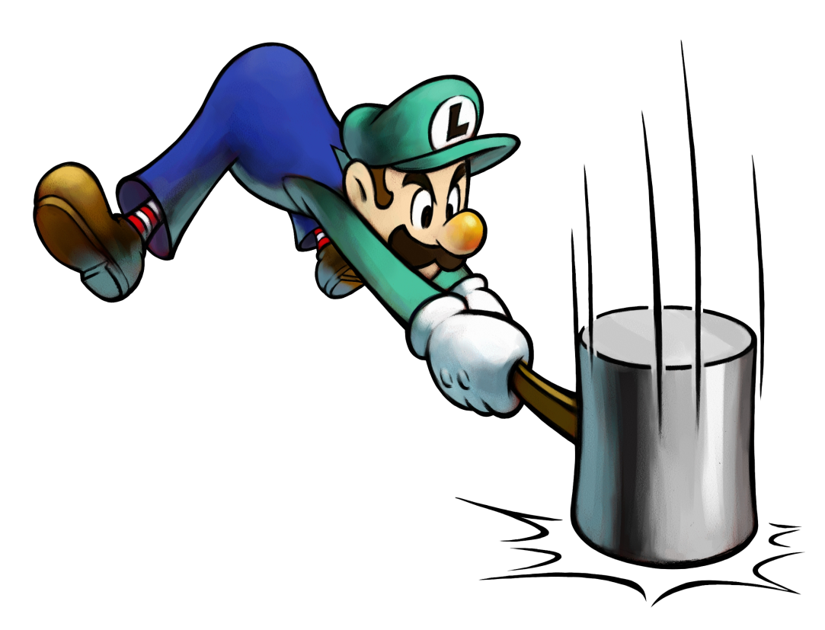
Ex.
Luigi is sick of taking orders. He swings a 9.0 kg hammer at 16 m/s when Mario’s mustache brings it to a stop in 0.25 s. What is the net force exerted on Mario’s mustache?

Slide 4
Ex.
A soccer player kicks a 0.450 kg ball at 25.0 m/s east. If the goalie stops the ball by exerting 215 N of force, how long does it take the ball to stop?
If the goalie stops a 6.5 kg bowling ball traveling at the same velocity in the same amount of time, how much force is required?

Slide 5
Example
A student jumps off a desk. When they land they bend their knees on impact. Why does this help prevent some serious damage to their knees?

Slide 6
Example
Coaches for many sports such as baseball, tennis and golf can often be heard telling their athletes to “follow through” with their swing.
How does this help a weaker player hit a ball farther than a stronger player?

Slide 7
Example
Using the principle of impulse explain why an airbag can help people sustain less damage during a collision.

