Slide 1
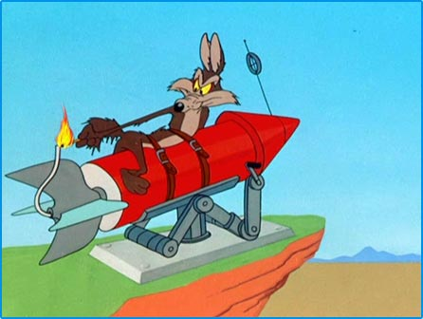
Potential and Kinetic Energy

Slide 2
There are many forms of energy: mechanical, thermal, electrical, nuclear, chemical etc. One form can be converted into another by doing work.
In this chapter will be concerned mostly with potential and kinetic (and just a hint of thermal) energy.

Slide 3
Potential Energy (E_{p}): stored energy. We will first concern ourselves with gravitational potential energy.
Cause math is fun!
Deriving the E_{p} formula…
E_{p} = Fd
(in this case F = F_{g} = mg)
E_{p} = mgd
(let’s change letters just for fun, and call h the vertical displacement)
E_{p} = mgh
HOORAY!
E_{p} = mgh
Example
A 1000 kg boulder sits on a 50 m ledge, precariously perched above a biology student. How much potential energy does the boulder have relative to the student?
Remember:
Potential energy is always measured relative to a certain point.

Slide 4
Kinetic Energy (E_{k}): energy of motion. We will only concern ourselves with translational kinetic energy.
E_{k} =
Cause math is fun!
Deriving the E_{k} formula…
v² = v_{o}² + 2ad
(take v_{o} = 0)
v² = 2ad
(but a = F/m)
v² = 2Fd m
(but Fd=W= E_{k}, if v_{o} = 0)
v² = 2E_{k} m
E_{k} = ½mv²
SUCCESS!!
E_{k} = ½mv²
Example
Remember that biology student hanging out below the 1000 kg boulder? If the boulder falls the full 50 m onto the student below, how much kinetic energy will it have just before impact?

Slide 5
Work-Energy Theorem for Net Force
One last thing on kinetic energy…
It is important to notice that the work done by the net force on an object is equal to the change in its kinetic energy:
W_{net} = ΔE_{k}
or
F_{net}d = ½m(v² – v_{o}²)
Note: In this case we use F_{net} because it is the accelerating force.

Slide 6
Example:
A 1270 kg car accelerates from 15 m/s to 25 m/s over a distance of 75 m. Determine the average net force that was required to do this.

Slide 7
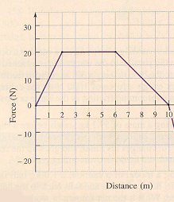
F_{net} vs d Graphs
Example:
The graph shows a variable force working on a 10.0 kg mass on a level surface, initially at rest. Find:
The total amount of work done after 10 m.
The final speed of the object. Assume friction is negligible.

