Slide 1
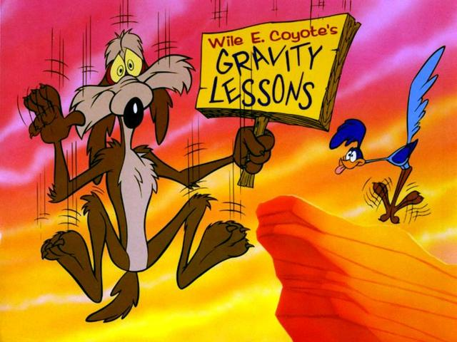
Potential Energy

Slide 2
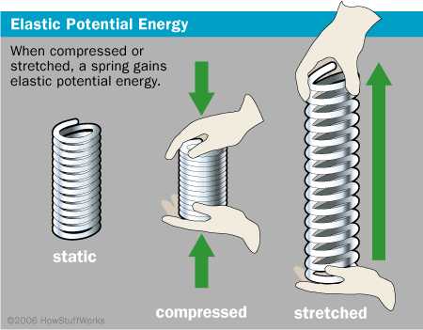
Potential Energy: Energy that is stored
Examples
Elastic

Slide 3
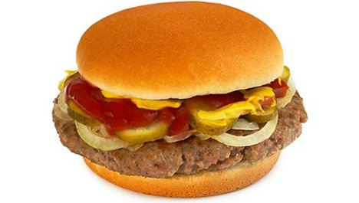
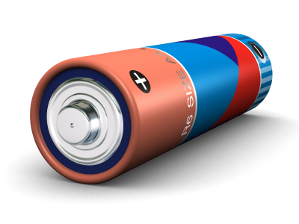
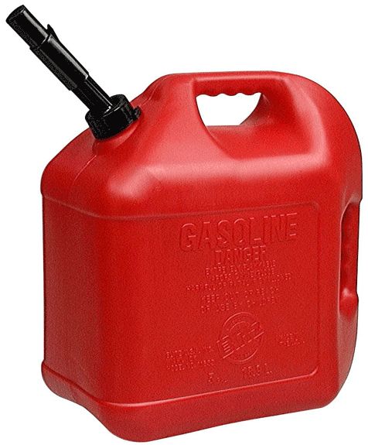
Potential Energy: Energy that is stored
Examples
Chemical

Slide 4
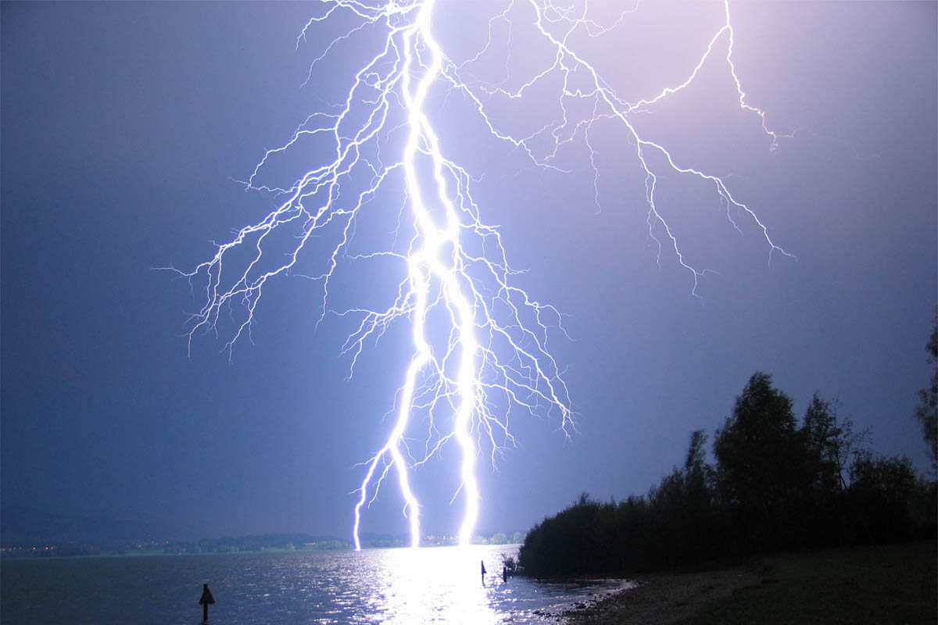
Potential Energy: Energy that is stored
Examples
Electric

Slide 5
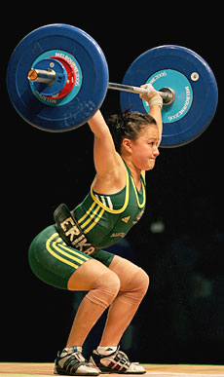
Potential Energy: Energy that is stored
Examples
In this class we will focus on gravitational potential energy.
This is stored energy due to its position above the Earth.
Remember: Energy transferred from one object to another by doing work.

Slide 6
Work converts energy into different forms
Imagine a boulder on a cliff above Wile E. Coyote
The boulder has potential energy due to its position.
It has the potential to fall and do work on him.
Horribly painful work.

Slide 7
Gravitational Potential Energy
E_{p} = mgh
Note that this is the same formula we used for work done against gravity!!!
Where:
E_{p} = potential energy
m = mass
g = acceleration due to gravity
h = height

Slide 8
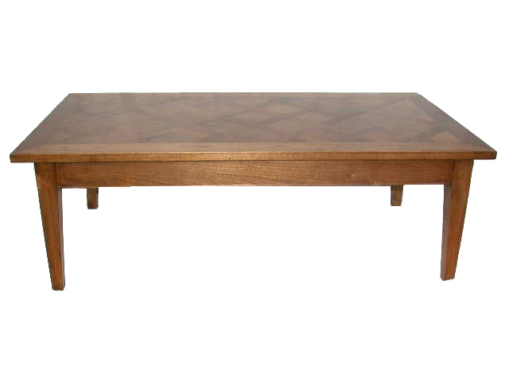
Gravitational potential energy is always measured relative to some reference point.
Ex.
A 15.0 kg textbook is sitting on a 1.20 m tall table. If the book is lifted 0.80 m above the table, how much gravitational potential energy does it have
a. with respect to the table?
b. with respect to the floor?

Slide 9
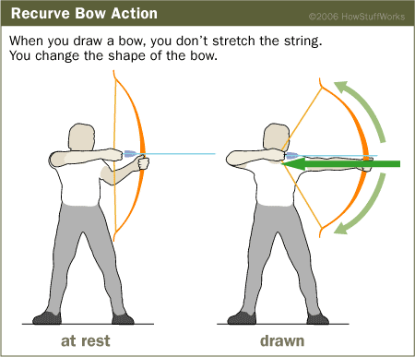
Ex 2.
An archer pulls on a bow string with an average force of 240 N while drawing the arrow back a distance of 0.200 m. Calculate the potential energy of the bow-arrow system.
HINT: The work done to the bow is all being stored as potential energy.

