Slide 1
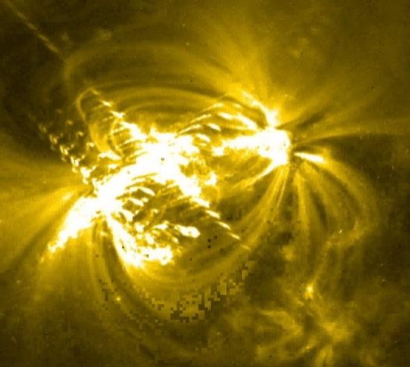
Light and Sound

Slide 2
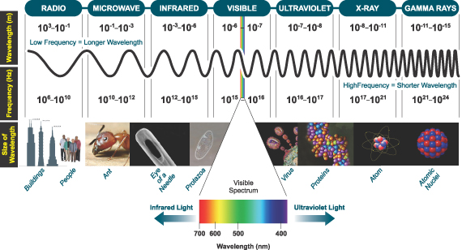
Light is a form of electromagnetic radiation that includes:

Slide 3
EM Radiation
Transverse waves of energy
The speed of light depends on its medium (more dense → slower)
The speed of light (in a vacuum)
c = 3.00x10⁸ m/s
This is the universal speed limit…
nothing can go faster than light

Slide 4
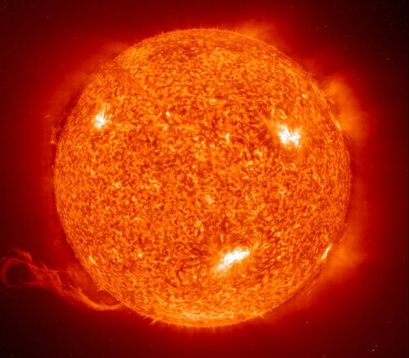
Ok try these…
The Sun is 1.50x10⁸ km from Earth. How long does it take for the light from the Sun to reach us?
Alpha Centauri is the nearest solar system to ours, at 4.07x10¹³ km away. How long does it take for light to travel from Alpha Centauri to us?

Slide 5
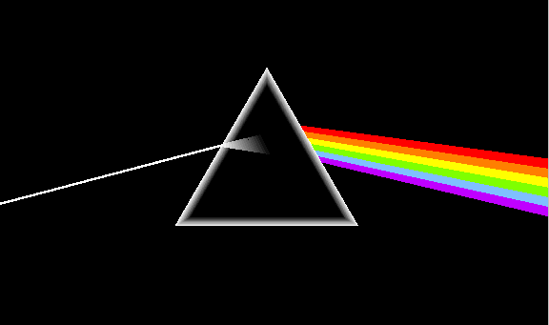
White light is actually a mixture of many different colours (ROY G BIV)
Different colours of light have different wavelengths and frequencies. Red has the longest λ and violet the shortest λ.

Slide 6
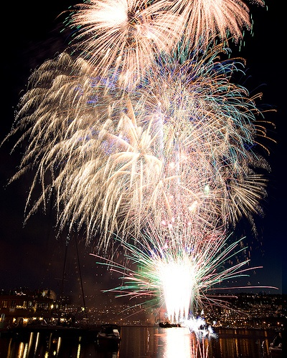
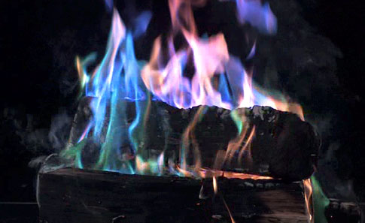
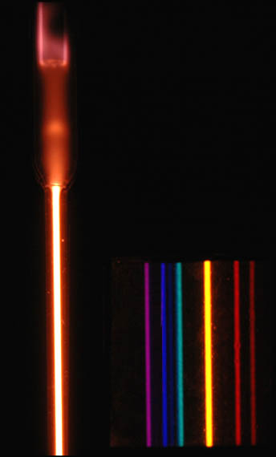
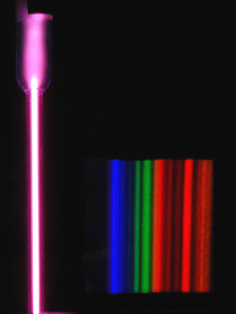
EM Radiation is emitted from energized matter
After energy is absorbed by matter, it is emitted as EM Radiation.
Each element emits very specific frequencies (colours) of light called atomic spectra.
Helium
Argon

Slide 7
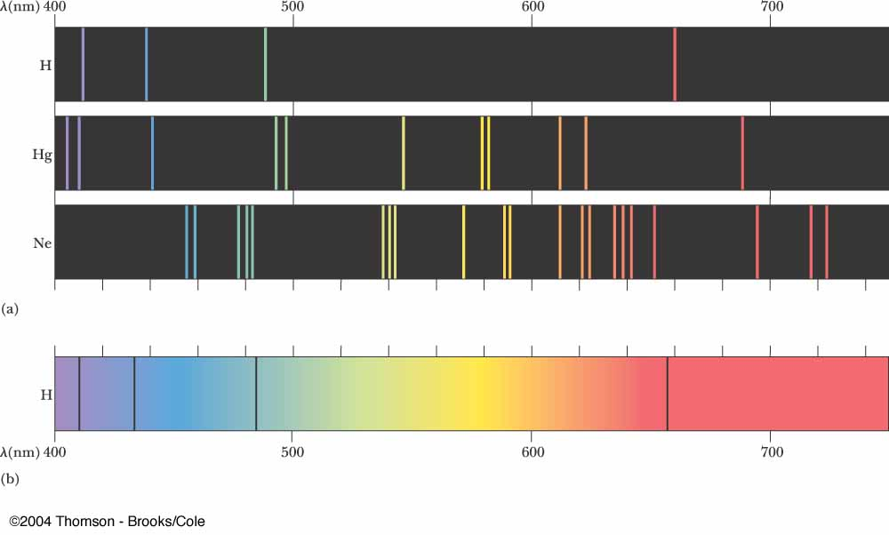
EM Radiation is emitted from energized matter
Hydrogen
Mercury
Neon
Black Body

Slide 8
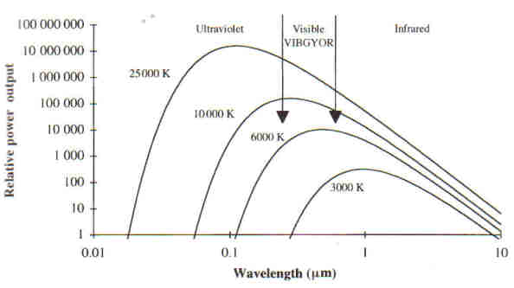
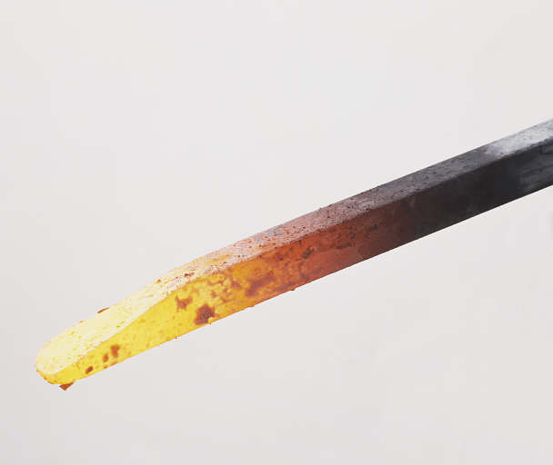
EM Radiation is emitted from energized matter

Slide 9
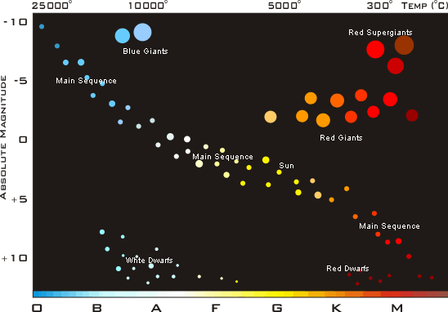
EM Radiation is emitted from energized matter

Slide 10
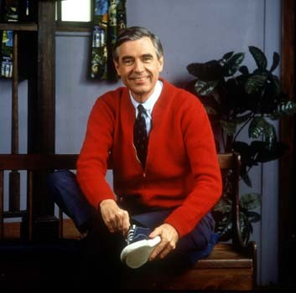
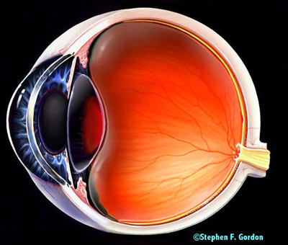
How We See...
White light
Red light Reflected
All other λ absorbed

Slide 11
Sound
Longitudinal waves of pressure that stimulate our ear drums
The speed of sound depends on its medium (more dense → faster)
Pitch is determined by frequency
Volume is determined by amplitude

Slide 12
Determining Maximum and Minimum Audible Frequencies
With the frequency generator determine the minimum and maximum frequencies of sound that you can still hear.
f_{min}: _________ Hz f_{max}:_________ Hz
Assuming that the speed of sound in air is 343 m/s, determine the max and min wavelengths.
λ_{min}: _________ m λ_{max}: _________ m

Slide 13
The doppler effect
Imagine a water bug standing on the surface of a pond, bouncing up and down.

Slide 14
The doppler effect
Now imagine that bug skimming along the surface of a pond.
The waves in back are spread out.
- Larger λ
- Lower f
The waves in front get compacted.
- Smaller λ
- Higher f

Slide 15
The doppler effect

Slide 16
The doppler effect and Red Shift

