Slide 1
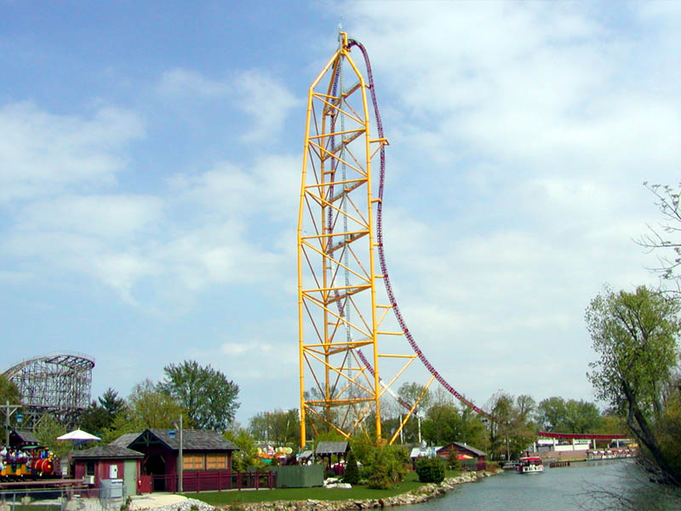
Conservation of Mechanical Energy

Slide 2
Energy cannot be created or destroyed, only changed from one form into another. Therefore in a closed system the total energy is always constant.
When only conservative forces (such as gravity) act on an object kinetic energy is transferred into potential energy and vice versa.
Consider a ball being thrown up into the air and returning to the thrower.

Slide 3
In this case The Law of Conservation of Energy states that the total amount of energy is constant, or the total change in energy is ZERO:
Total ∆ Energy = ΔE_{k} + ΔE_{p} = 0
ΔE_{k} = - ΔE_{p}
½mΔv² = - mgΔh
1/2m(v² – v_{o}²) = - mg(h_{f} - h_{i})
Note: The speeds are squared before you subtract them.

Slide 4
Example
A ball is thrown in the air with a velocity of 14 m/s. How high above its point of release is it when it has a speed of 4.0 m/s?

Slide 5
Another way of thinking of The Law of Conservation of Energy is that in a closed system the total energy must be constant.
Or the total initial energy must equal the total final energy.
Total Energy = ΔE_{k} + ΔE_{p} = 0
½m(v² – v_{o}²) = - mg(h_{f} - h_{i})

Slide 6
Example
The first peak of a roller coaster is 55 m above the ground. The 1200kg car starts from rest and goes down the hill and up the second hill which is 30 m high. How fast is the car traveling at the top of the second hill?
Insert sub-par picture here.

Slide 7
Back in grade 11 it really was that easy…
When non-conservative forces (such as friction) act on an object, not all energy is transferred between kinetic and potential.
This is what physicists have termed REALITY. Deal with it.
The “work” done by friction does produce another form of energy known as:
Thermal Energy or Heat
This energy is quickly conducted or radiated in all directions and effectively dispersed.

Slide 8
Consider a block of wood sliding down a ramp with a small amount of friction.
How would the block’s kinetic energy at the bottom compare to its potential energy at the top? Why?

Slide 9
The fact that the amount of energy in the block decreases as it slides down the ramp doesn’t change the fact that the total energy in the system is CONSTANT. We need to modify our earlier equation for The Law of Conservation of Energy only slightly:
Total Energy Initial = Total Energy Final

Slide 10
Example
A 5.0 kg block of wood is now shoved down a ramp at an initial velocity of 6.0 m/s. At the bottom of the ramp it is traveling at 7.5 m/s. How much thermal energy is generated due to friction?
3.5 m
1.5 m
A little Crippler for you..
What is the coefficient of friction between the block and the ramp?

