Slide 1
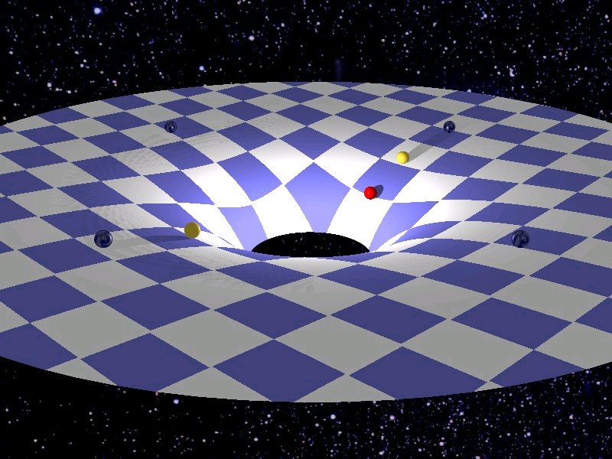
Gravitation

Slide 2
Newton discovered that gravity attracts any two objects depending on their masses and their distance.
Fg is proportional to the two masses:
Fg is proportional to the inverse of the square of their distances between their centers of mass:

Slide 3
Newton’s Law of Universal Gravitation
F_{g} =

Slide 4
Example
Calculate the force of gravity between two 75 kg students if their centers of mass are 0.95 m apart.

Slide 5
Common Question Alert!!!
A satellite weighs 9000 N on Earth’s surface. How much does it weigh if its mass is tripled and its orbital radius is doubled?

Slide 6
Mass vs. Weight
Mass
Amount of matter in an object
Constant (relatively) throughout the universe
Weight
Gravitational attraction (weight)
Changes depending on where you are in a gravitational field

Slide 7
Satellites in Orbit
A satellite of the Earth, such as the moon, is constantly falling. But it does not fall towards the Earth, rather it falls around the Earth. Just as if you were in an elevator that was falling towards the Earth you would feel weightless if you were on an artificial satellite falling around the Earth.
Consider the Moon:

Slide 8
Example: A 4500 kg Earth satellite has an orbital radius of 8.50x10⁷ m. At what speed does it travel?

