Slide 1
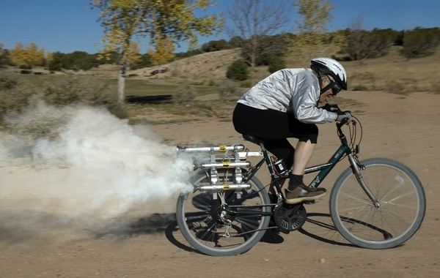
Kinetic Energy

Slide 2
Kinetic Energy: Energy of moving objects.
Scalar value
Measured in Joules (J)
Where:
m = mass
v = speed
E_{k} = ½mv²

Slide 3
Example
A 60.0 kg student is running at a uniform speed of 5.70 m/s. What is the kinetic energy of the student?

Slide 4
Example
The kinetic energy of a 2.1 kg rotten tomato is 1.00 x 10³ J. How fast is it moving?

Slide 5
The Work Energy Theorem
If a net force acts on an object then it must be accelerating.
This acceleration is proportional to its change in kinetic energy.
Therefore:
W = F_{net}d = ∆E_{k}

Slide 6
Example
A sprinter exerts a net force of 260 N over a distance of 35 m. What is his change in kinetic energy?

Slide 7
Example
A student pushes a 25 kg crate which is initially at rest with a force of 160 N over a distance of 15 m. If there is 75 N of friction, what is the final speed of the crate?

