Slide 1
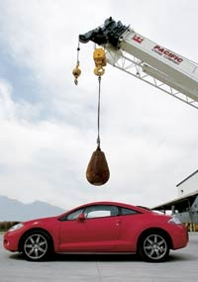
Torque not at 90º

Slide 2
Although we’ve already learned about torque, we don’t quite have the whole story. So far we have only seen torque provided by forces acting perpendicular to the body in equilibrium. What happens if a force acts in a direction other than perpendicular to the body?

Slide 3
Ex A 2.2 m long 50.0 N uniform beam is attached to a wall by means of a hinge. Attached to the other end of the beam is a 100 N weight. A rope also helps support the beam as shown.
a) What is the tension in the rope?
b) What are the vertical and horizontal components of the supporting force provided by the hinge?
30º
100 N

Slide 4
First we redraw the beam with the forces acting on it and their distances from the pivot.
Notice that if we break the tension in the rope into component forces, the parallel component does not contribute to the torque in either the clockwise or counterclockwise direction.
So, whenever we are calculating the torque on a body we must ALWAYS use the perpendicular component of any force.

Slide 5
RULE NOT TO BREAK LEST YE BE BROKEN:
When we find the torque acting on a body we MUST ALWAYS use the component of the force that is perpendicular to the rotating body!!!
Ex
A 1.8 m long 12.0 kg bar is attached to a wall by a hinge and supported by a rope as shown. Find the tension in the rope.
T
1.8 m
32º

Slide 6
Ex
Find the mass of the object given the information in the diagram and that the mass of the uniform beam is 115 N.
T = 675 N
Mass = ???
50º

