Slide 1
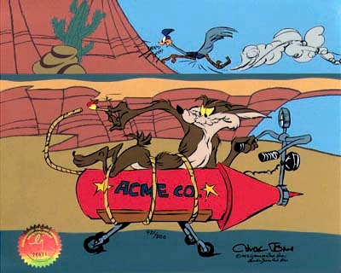
Free Body Diagrams

Slide 2
Free body diagrams show the magnitude and direction of ALL of the forces acting on an object.
Generally we represent the object as a box with the force arrows coming out from the centre, in the direction they are acting.
Remember that the size of the arrow indicates its relative magnitude.

Slide 3
Force | Description
F_{app} | Applied force
F_{f} | Force of friction, generally resists motion
F_{g} | Force of gravity, weight
F_{N} | Normal force, perpendicular to surface
T | Tension, force along a rope or string
F_{E} | Elastic force
F_{Air} | Air friction

Slide 4
Ex.
A box is pushed across a rough surface at a constant velocity.
A hockey player glides on frictionless ice at a constant velocity.

Slide 5
1. A book is at rest on a table top. Diagram the forces acting on the book.

Slide 6
2. A girl is suspended motionless from a bar which hangs from the ceiling by two ropes.

Slide 7
3. An egg is free-falling from a nest in a tree. Neglect air resistance. Diagram the forces acting on the egg as it is falling.

Slide 8
4. A plane flies at a constant velocity (Note: there will be an applied force generated by the engines as well as a lift force provided by the wings).

Slide 9
5. A rightward force is applied to a book in order to move it across a desk with a rightward acceleration. Consider frictional forces. Neglect air resistance. Diagram the forces acting on the book.

Slide 10
6. A rightward force is applied to a book in order to move it across a desk at constant velocity. Consider frictional forces. Neglect air resistance. Diagram the forces acting on the book.

Slide 11
7. A college student rests a backpack upon his shoulder. The pack is suspended motionless by one strap from one shoulder. Diagram the vertical forces acting on the backpack.

Slide 12
8. A skydiver is descending with a constant velocity. Consider air resistance. Diagram the forces acting upon the skydiver.

Slide 13
9. A force is applied to the right to drag a sled across loosely-packed snow with a rightward acceleration. Diagram the forces acting upon the sled.

Slide 14
10. A football is moving upwards towards its peak after having been booted by the punter. Diagram the forces acting upon the football as it rises upward towards its peak.

Slide 15
11. A car is coasting to the right and slowing down. Diagram the forces acting upon the car.

