Slide 1
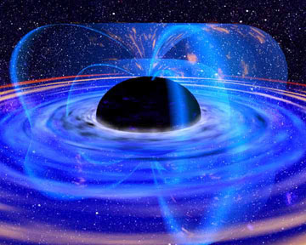
Gravitational Fields

Slide 2
Scientists had difficulty explaining how two objects that are not in contact can exert a force on one another. In order to help conceptualize how this can occur, we had invented the idea of FIELDS.
A field is defined as an area of influence.

Slide 3
To help imagine how these fields work, consider a campfire. It seems as though the fire is emitting a heat field.
As you approach the fire the field strength increases.
As you increase the size of the fire the field strength increases.
Just like this so-called heat field, gravitational fields surround any mass. Just like any other value, fields can be described as either vector or scalar.

Slide 4
While heat is measured by temperature (a scalar) its field is also scalar.
Gravitational fields are force fields and as such are vectors.

Slide 5
Vector fields, like vector quantities, are represented by arrows. In this case, the density of the arrows represent the magnitude of the field strength…

Slide 6
We are already quite familiar with gravitational field strength by its other name acceleration due to gravity.
Recall:
F_{g} = mg
Therefore
Where g = acceleration due to gravity
= gravitational field strength
= 9.8 m/s² near Earth’s surface
g = F_{g}
m

Slide 7
This formula works fine if we stay put on Earth, but it falls way short once we leave Terra Firma, because the Earth’s gravitational field changes depending on how far you are from Earth’s surface. However, we can derive a more useful formula:
g = GM
r²

Slide 8
Example:
What is the gravitational field strength on the surface of the Moon?
m_{moon} = 7.35x10²² kg
r_{moon} = 1.74x10⁶ m

Slide 9
Example:
A satellite orbits the Earth at a radius of 2.20x10⁷ m. What is its orbital period?

Slide 10
Geosynchronous Orbit
The orbital speed of a satellite will depend on the strength of gravitational field at the orbital radius.
Consider the following situations. Which identical satellite will be travelling faster in each. case? Why?
1) Satellite A orbits the Earth at twice the orbital radius of Satellite B.
2) Satellite A orbits the Sun at the same orbital radius that Satellite B orbits the Earth.

Slide 11
The orbital period of the satellite depends only on the mass of the planet and the orbital radius of the satellite.
It stands to reason therefore that at a certain orbital distance the orbital period will match the rotational period of the planet.
Such a satellite is said to be in geosynchronous (or geostationary) orbit.

Slide 12
Example:
Find the orbital radius of a satellite that is geostationary above Earth’s equator.
What is the speed of this satellite?

