Slide 1
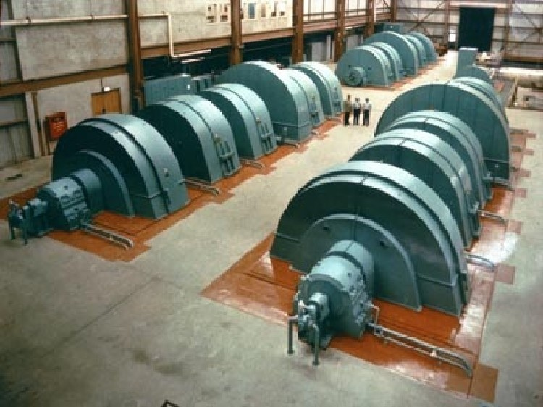
Power and Efficiency

Slide 2
In everyday language we often use the words WORK, ENERGY and POWER synonymously. However this makes the physics gods extremely furious because we should all know that:
POWER is the rate of doing work.

Slide 3
Mathematically we define power as:
The unit of power is J/s or Watts (W)
(this is sometimes confusing because W is also the symbol for work)
P = W/t = ΔE/t

Slide 4
Example:
A physics student is setting up a wicked body slam on a biology student. He lifts the 75 kg student clear over his head to a height of 2.2 m in 0.675 s. How much power did the physics student generate?

Slide 5
Example:
While cruising along level ground in the CT-2004 at 12.0 m/s, Mr. Trask hits the gas and speeds up to 26.0 m/s in 1.5 s. If the CT-2004 weighs 6.50 x 10⁴ N how much power did it generate? Ignore friction.

Slide 6
Another useful equation for power can be derived:
P =
=
= This is useful for objects moving at...

Slide 7
Example:
A student pushes 14 kg of their physics homework up a 40º ramp at a constant velocity of 3.2 m/s. The friction force is 26 N. How much power must the student exert?

Slide 8
Whenever we use a machine to do work some of the energy we put into the machine is always lost, mainly due to friction.
For example:
an electric heater is ________ efficient
a car is __________________ efficient
a lightbulb is _____________ efficient

Slide 9
We can define efficiency in two ways:
Efficiency = W_{out} x 100% = P_{out} x 100% W_{in} P_{in}
Notice that efficiency is a ratio expressed as a percentage and therefore has no units!

Slide 10
The most common source of confusion when calculating efficiency is in understanding which values applies to work/power IN and which applies to work/power OUT.
Work/Power In:
Total work or power used
Always greater than output
Work/Power Out:
Actual work or power done by the machine

Slide 11
Remember that energy is always LOST somewhere in using the machine, so:
Work IN > Work OUT
and
Efficiency < 100%

Slide 12
Example:
A 300 W electric motor lifts a 25.0 kg object to a height of 10.0 m in 11.5 s. What is the efficiency of the motor?

Slide 13
Example:
A student pushes a 15 kg box up a ramp with a force of 95 N. What is their efficiency?
12 m
9.0 m
6.0 m
5.0 m

