Slide 1
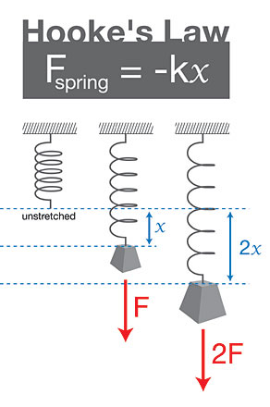
Hooke’s Law

Slide 2
F_{Elastic}: The force that works to return a distorted object to its equilibrium (rest) position.
Ex

Slide 3
Hooke’s Law: The size of an elastic force is proportional to the distortion of the object.
or
F_{E} = kΔx

Slide 4
Where:
k (N/m) = the spring constant The stiffer the spring the higher it is Is constant for given material.
Δx (m) = distortion from equilibrium

Slide 5
Ex: A student stretches an elastic band with a spring constant of 50.0 N/m by 15 cm. How much force are they applying?

Slide 6
Ex: Al McInnis uses a wooden stick with a spring constant of 850 N/m. What is the distortion on the stick if he exerts 525 N while taking a slapshot?

Slide 7
Ex: A 65 kg girl sits in a redneck sling shot that has a spring constant of 10.5 N/m. If the sling is stretched by 45 m, what is her initial acceleration when released?

