Slide 1
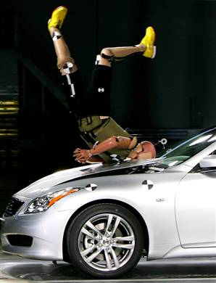
Momentum and Collisions

Slide 2
Momentum is a quantity of motion that depends on both the mass and velocity of the object in question.
p = mv
The units of momentum are _________ or ___________.

Slide 3
Momentum is a vector quantity, with the same sign as its velocity.
As with any vector you can assign any direction as positive and the opposite as negative.
As convention we will generally refer to up or to the right as positive and down or to the left as negative.

Slide 4
Momentum is similar to inertia - the tendency of an object to remain at a constant velocity. Where as inertia depends only on mass, momentum depends on mass AND velocity.
Consider this:
A tennis ball traveling at 10 m/s and a medicine ball traveling at 10 m/s. Which one is more difficult to stop?
OK now this one:
A baseball traveling at 5 m/s and a baseball traveling at 50 m/s. Which one is harder to stop?

Slide 5
Example:
A baseball pitcher hurls a 0.45 kg ball at 32 m/s. The batter crushes it and the ball leaves the bat at 48 m/s in the opposite direction. What was the ball’s change in momentum?
Remember that momentum is a VECTOR which means we have to consider its DIRECTION.

Slide 6
The Law of Conservation of Momentum
Momentum is a useful quantity because in a closed system it is always conserved. This means that in any collision, the total momentum before the collision must equal the total momentum after the collision.
p_{initial} = p_{final}
for a collision involving two bodies,

Slide 7
First we are going to consider linear 1-D interactions.
There are 3 general types of these collisions:
(1) Collision where the two bodies don’t stick together
Example:
A 1200 kg car heading east at 35 m/s collides with a 1550 kg truck traveling west at 27 m/s. After the collision the truck is traveling east at 6.0 m/s. What is the final velocity of the car?
Before After
m_{1i} = m_{2i} = m_{1f} = m_{2f} =
v_{1i} = v_{2i} = v_{1f} = v_{2f} =

Slide 8
(2) Collision where the bodies do stick together
Example:
A 9500 kg caboose is at rest on some tracks. An 11000 kg engine moving east at 12.0 m/s collides with it and they stick together. What is the velocity of the train cars after the collisions?
Before After
m_{1i} = m_{2i} = m_{total} =
v_{1i} = v_{2i} = v_{f} =

Slide 9
(3) Explosion
Example: An object…no wait…a fluffy little bunny suddenly explodes in a stunning display of gore. The bunny splits into exactly two parts, the first part has a mass of 2.2 kg and flies due east at 26 m/s. The second chunk heads due west at 34 m/s. What was the initial mass of the bunny?
Before After
m_{total} = m_{1f} = m_{2f} =
v_{i} = v_{1f} = v_{2f} =

