Slide 1
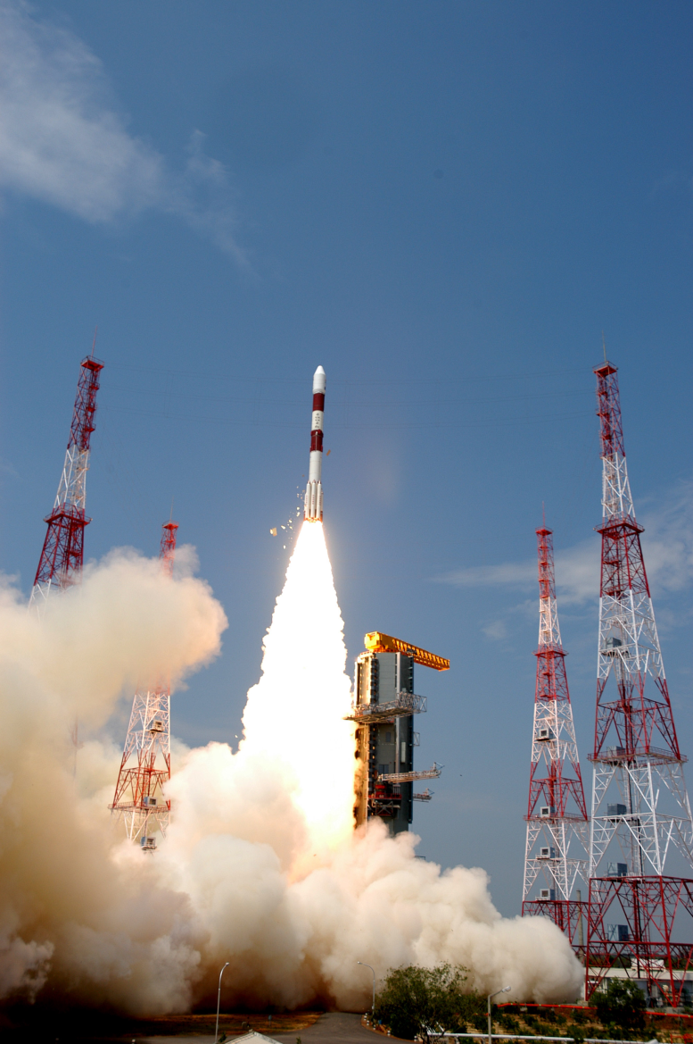
Newton’s 3rd Law

Slide 2
Newton’s 3rd Law
“For every action force there is an equal (in magnitude) and opposite (in direction) reaction force.”
Any interaction involves two forces that we call action-reaction force pairs.

Slide 3
Examples:
1) You hit a baseball with a bat.
The bat hits the ball - the ball hits the bat
2) A sprinter starts running.
The sprinter pushes the ground - the ground pushes the sprinter
3) A fish swims through water.
The fish pushes the water backwards - the water pushes the fish forwards

Slide 4
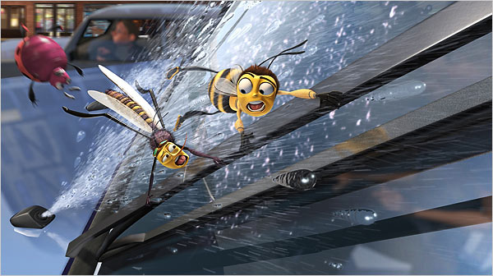
Imagine a bug hitting the windshield of a semi trailer.
What force pair occurs?
Which force is bigger?
Which object has a greater acceleration?
Hands up if you hate Newton!!!
Bug hits truck –
Truck hits bug
NEITHER!!!
Since, a = F_{net}
m
the truck has a much smaller acceleration because it is much, much more massive.

Slide 5
Some other common examples of Newton’s 3rd Law at work include:
1) When firing a gun, the gases push forward on the bullet AND backwards on the gun…

Slide 6

2) While breaking bricks you have to exert enough force to break them all…
or else…

Slide 7

3) When a rocket lifts off, the gasses are pushed out of the back of the rocket, which means…

