Slide 1
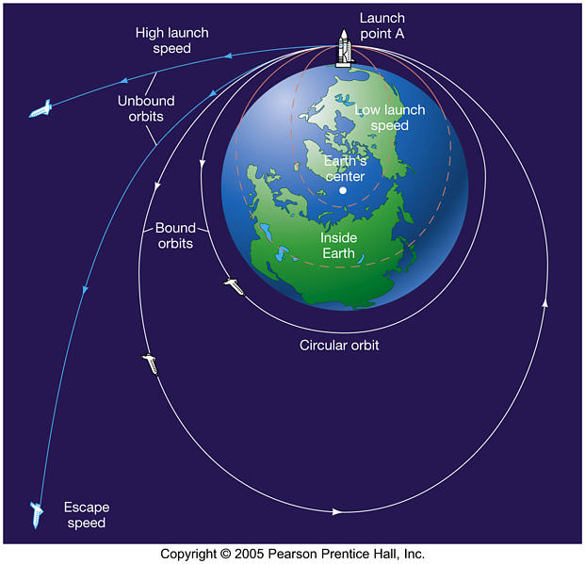
Potential Energy and Escape Velocity

Slide 2
Gravitational Potential Energy
We have already discussed gravitational potential energy. E_{p} = mgh
However, as we have seen, g is not a constant but rather depends on mass of and distance to an object.
Let’s Derive!!!
g = Gravitational Field Strength E_{p} = Potential Energy
E_{p} = - Gm₁m₂
r

Slide 3
If you look at your formula sheet you will notice that this equation has a negative sign.
What’s the deal?
Whenever we talk about gravitational potential energy, we have to use a reference point.
At this reference point we assign a gravitational potential energy of ZERO.

Slide 4
When determining the potential energy on a mass provided by the gravitational force generated by a second mass, we assign the ZERO reference point when the distance between the objects is infinite.
This means whenever the objects get closer together the potential energy between them gets less.
Compared to infinity the potential energy of the object will always be negative.

Slide 5
Let’s sketch a graph showing the relationship between gravitational potential energy of one object relative to another and the distances between their centers.

Slide 6
Example:
A 2500 kg satellite is in orbit 3.60x10⁷ m above the Earth’s surface. What is the gravitational potential energy of the satellite due to the gravitational force caused by the Earth?
Note: The potential energy of this satellite relative to some infinite position is negative!!

Slide 7
Example cont:
What is the total energy of the satellite in the last question?

Slide 8
Change in Potential Energy

Slide 9
Example:
How much work is required to move a 4500 kg Earth satellite from an orbital radius of 1.8x10⁷ m to a radius of 4.2x10⁷ m?

Slide 10
Example:
The International Space Station drops a 250 kg waste shuttle from rest at an altitude of 3.50x10⁵ m. At what speed would it impact Earth if there were no air friction?

Slide 11
Example:
A 2.35x10¹⁶ kg asteroid falls towards the Earth from a really, really, REALLY far way away. How much energy is released when it impacts with the Earth?

Slide 12
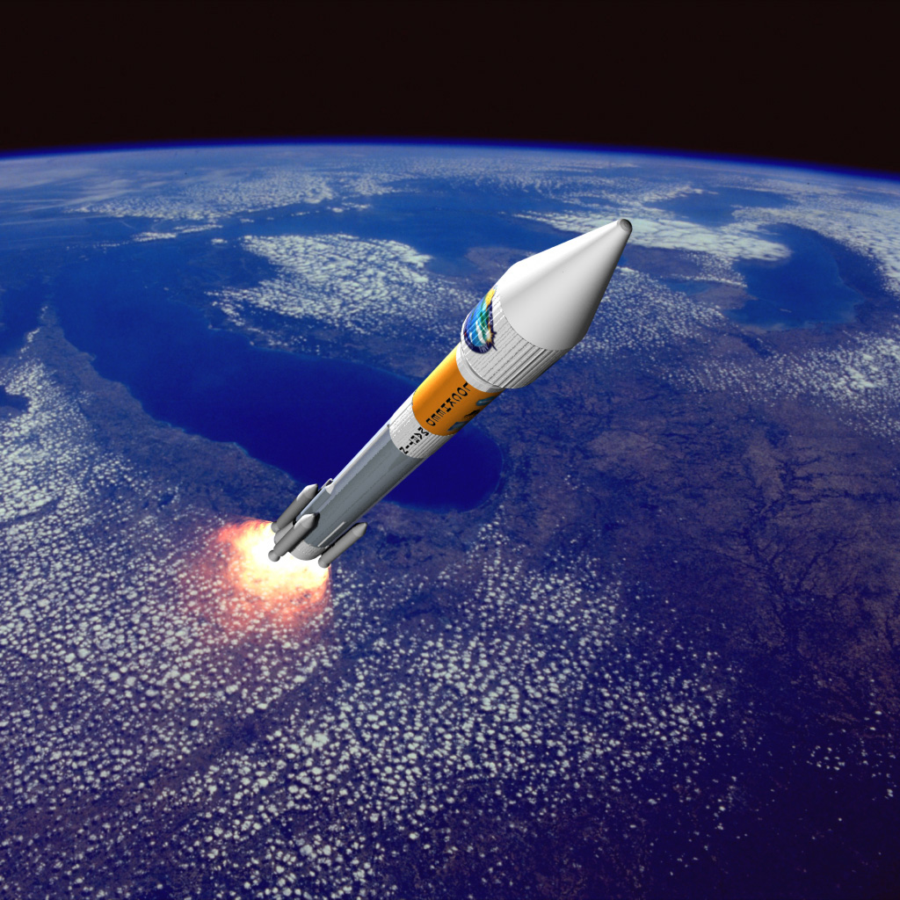
Launching (Escape Velocity)
What goes up must come down, unless we throw it really, REALLY hard.
Escape velocity is the minimum speed an object requires in order to completely break free from Earth’s pull. It should stand to reason that if an object is going to be completely freed from the Earth’s gravitational pull that we need to supply it with enough kinetic energy to match its potential energy at infinite.

Slide 13
In terms of equations this means that:

Slide 14
Example:
At what speed do you need to throw a 1.0 kg rock in order for it to leave the Earth’s gravitational pull?
Does the mass of the rock matter? Hmmm…

