Slide 1
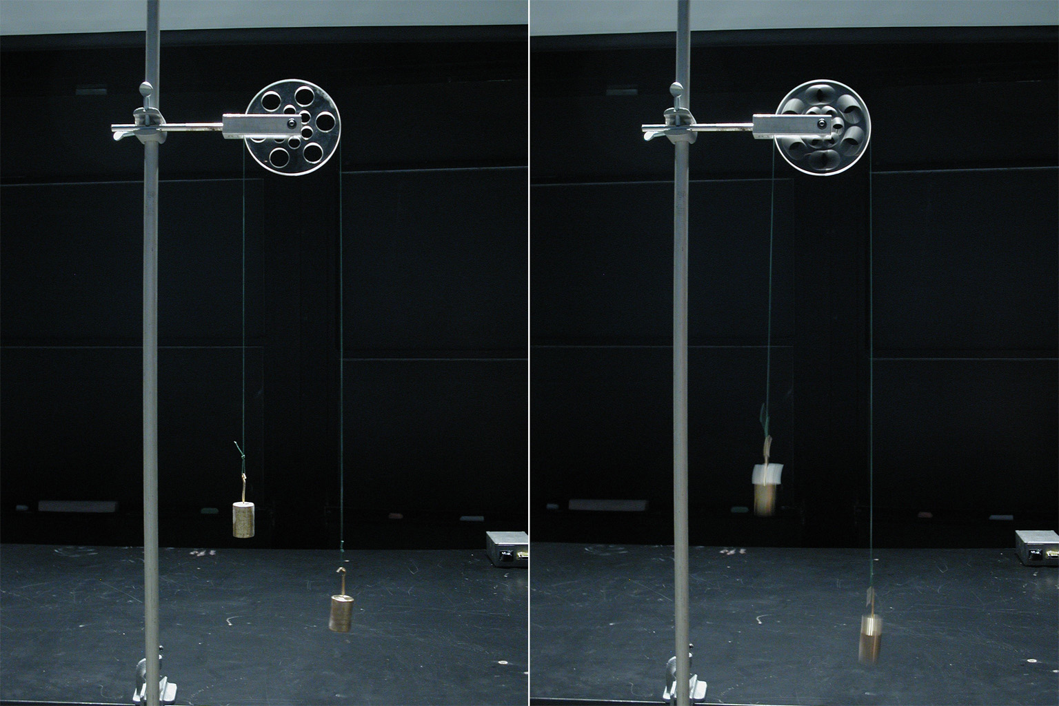
Two Objects and Tension

Slide 2
There are a number of common force problems that involve 2 objects, that you will be expected to be able to solve.
We will focus on 3 of these.

Slide 3
1) Atwood’s Machine: Two masses suspended by a pulley
Diagram: Include all forces at work on the two masses.
Both masses have a F_{g} that pull downwards, but since they are connected by a pulley those forces work in opposition.
The masses will accelerate so that the heavy mass moves downward.
Since they are attached by a rope the acceleration of the masses must be equal.

Slide 4
Note that there is a force of TENSION (T) that exists along the rope. Tension acts the same as all other forces, with two important peculiarities:
1) It is an internal force, acting along the rope in BOTH directions.
2) It cancels out of the total net force equation (so long as the rope is not stretching)

Slide 5
The Strategies:
When solving these problems it is easiest for us to choose the direction of the larger mass moving downwards as the positive direction.
Remember that the acceleration on the two masses MUST BE EQUAL.
It can also be easier to conceptualize this problem if we “unfold” the masses and lay them out in a line, while keeping all of our forces as they are… …I know that sounds weird so, here’s an example.

Slide 6
Ex
Two masses are suspended from a lightweight rope over a frictionless pulley as shown. What will their acceleration be once released?
kg
kg
NOTE: When calculating the acceleration we use the total mass because the F_{net} is accelerating the entire system (both masses)!

Slide 7
Alright that wasn’t too hard, but can you find the tension in the rope?
If we use the same force diagrams and equations as before we hit a snag. The two tension forces CANCEL OUT !!!
This is because tension is an internal force.
In order to solve for tension we have to consider just one mass or the other.
Strategy: To solve for tension chop your diagram in half and only consider one of the masses. Either one is fine because the whole system has the same acceleration.
Note: When finding the tension we are only considering half of the equation therefore we only use one mass.

Slide 8
2) Multiple Horizontal Masses: Attached by a cord
Ex: Consider the masses shown. µ = 0.25 for both blocks.
a. the acceleration of the entire system
b. the tension at T₂
T₂
T₁ = 75 N
8.0 kg
6.0 kg
Remember: 1. When solving for acceleration we need to consider the total mass of the system. 2. When solving for tension we only consider half of the system.

Slide 9
3) The Hanging Mass: One mass hanging, one horizontal
Ex Consider the two masses shown. Find their acceleration and the tension in the rope.
8.0 kg
6.0 kg
Remember: We can “unfold” the rope and look at these two masses in linear sense.

Slide 10
Ex
Two forces are attached by a rope over a frictionless pulley as shown. (Assume the incline is frictionless) Determine:
a. The acceleration of the masses.
b. The tension in the rope.
m₁ =
4.0 kg
m₂ = 6.0 kg
30º
Problem: What direction will they accelerate?
In earlier pulley problems it was obvious, the bigger mass always wins. When an inclined plane is involved this is not always the case because for the mass on an incline only the parallel component of gravity is considered.

Slide 11
So determine the forces on each one separately and see which one is the winner.
Force 1 =________ Force 2 = _________
Ok, so the winner in this case is Fg₁ so we will take the direction it moves as positive….

Slide 12
Once we know the magnitude of the forces at work on the two blocks, this problem becomes very similar to the simpler pulley questions. Now solve for the acceleration and tension.

Slide 13
And just before you get comfortable here’s one more twist…
Ex In the name of physics, a monkey is attached to a sleeping sheep on a ramp. Don’t ask why. As we all know, the coefficient of friction for a sleeping sheep on a ramp is precisely 0.15. Determine:
a. The acceleration of the system.
b. The tension in the rope.
even adorabler sheep 28 kg
40º
adorable monkey 24 kg

Slide 14
Strategy:
1. Find the forces acting on the two bodies separately to determine a winner. 2. Determine the friction on the sheep. Friction can work either up or down the ramp (because it always opposes motion) so we don’t know which direction it is acting until we know the winner.
3. Based on the winner find the acceleration using m_{total}.
4. Choose either body and examine it separately to determine the tension in the rope.

