Slide 1
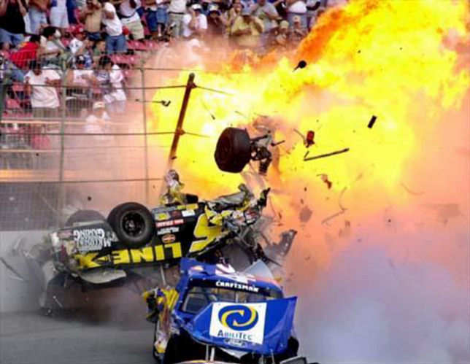
Elastic and Inelastic Collisions

Slide 2
Collisions can be grouped into two categories, elastic and inelastic.
Elastic Collisions:
Kinetic Energy is conserved
Inelastic Collisions:
Kinetic Energy is not conserved
In a perfectly inelastic collision the objects stick together.

Slide 3
In reality collisions are generally somewhere in between perfectly elastic and perfectly inelastic. As a matter of fact, it is impossible for a macroscopic collision to ever be perfectly elastic. Perfectly elastic collisions can only occur at the atomic or subatomic level.
However if objects collide and don’t stick together then there is some elastic component of the collision.

Slide 4
Example
A 225 g ball moving at 30.0 m/s to the right collides with a 125 g ball moving in the same direction at a velocity of 10.0 m/s. After the collision the velocity of the 125 g ball is 24.0 m/s to the right.
a. What is the velocity of the 225 g ball after the collision?
Before After

Slide 5
b. Is this collision elastic or inelastic? Prove it mathematically.
c. What happened to the kinetic energy lost?

