Slide 1
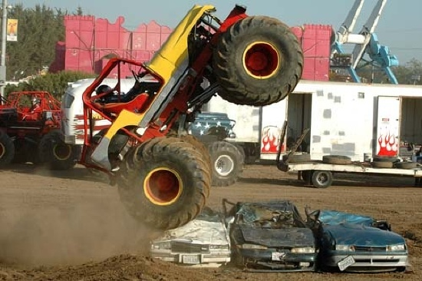
Power

Slide 2
Power is the rate of doing work.
Power and work are often thought of as being the same thing.
However, when we talk about work we are not concerned with time.
Power measured in J/s or Watts (W):
P = W = ΔE
t t

Slide 3
Example:
Lover’s Leap is a 122 m vertical climb. The record time of 4 min 25 s was achieved by Dan Osman (65 kg). What was his average power output during the climb?

Slide 4
Example:
A 1.00x10³ kg car accelerates from rest to a velocity of 15.0 m/s in 4.00 s. Calculate the power output of the car. Ignore friction.

Slide 5
Another useful formula…
Since:
P = W = Fd
t t
And:
v = d
t
Therefore:
P = Fv

Slide 6
Example:
A student uses 140 N to push a block up a ramp at a constant velocity of 2.2 m/s. What is their power output?
Note that this formula is only useful when moving at a constant velocity.

