Slide 1
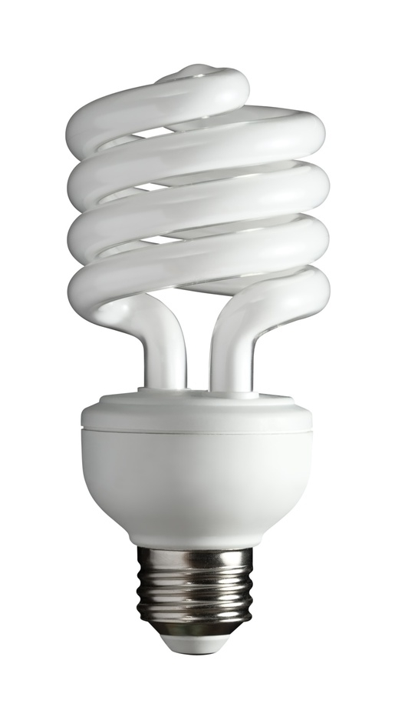
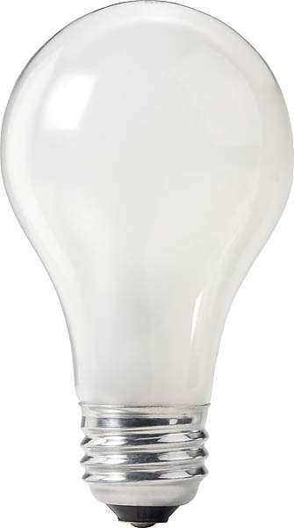
Efficiency
vs.

Slide 2
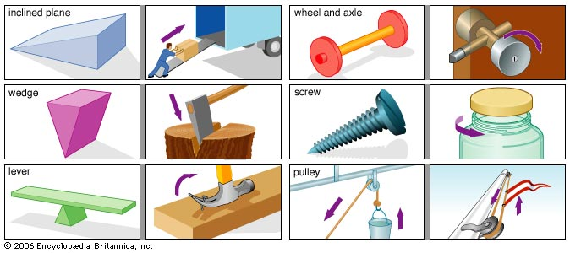
Efficiency is a measure of how much energy is wasted by a machine.
Machines are useful because they allow us to use less force over a longer distance to do the same work.

Slide 3
Machines always waste some energy.
The 2nd Law of Thermodynamics states that whenever work is done, some energy is converted to heat.
Therefore:
W_{in} > W_{out}
Work in: Energy supplied to the machine.
Work out: Work actually done by machine.

Slide 4
The efficiency of a machine is:
Efficiency = W_{out} x100%
W_{in}
or
There are no units for efficiency, it is simply expressed as a percentage.
Efficiency = P_{out} x100%
P_{in}

Slide 5
Example:
A lever is used to lift a 50.0 kg object 10.0 cm. To do this we must apply a force of 75 N to the end of the lever which displaces 1.00 m. Find the efficiency.
75 N
1.00 m
50.0 kg
50.0 kg
0.100 m

