Slide 1
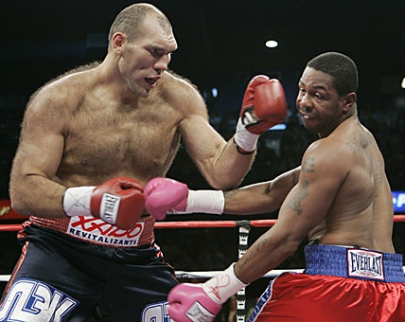
Impulse

Slide 2
Whenever a net force acts on a body, an acceleration results and so its momentum must change. We define the change in an object’s momentum as impulse.
Recall that momentum is the product of mass and velocity. Since we will not be dealing with changing masses, we can define an object’s change in momentum as:
Δp = mΔv

Slide 3
Keep that in mind while we do a little deriving…
If F_{net} = ma and a = Δv/t
So our equation for impulse can be written:
F_{net}t = mΔv

Slide 4
But what does this all mean? Let’s try to understand how forces relate to changes in momentum with a few examples.
Example
Coaches for many sports such as baseball, tennis and golf can often be heard telling their athletes to “follow through” with their swing. Why is this so important?

Slide 5
Example
A student jumps off a desk. When they land they bend their knees on impact. Why does this help prevent some serious damage to their knees?

Slide 6
Example
Conventional wisdom suggest that cars should be made as tough and rigid to prevent injury during a collision, however newer vehicles are all built with large crumple zones. Why?

Slide 7
Example
A beanbag and a high bounce ball of equal masses are dropped from the same height. If the force exerted by the floor acts for the same amount of time on each, which one exerts a greater average force on the floor?

Slide 8
Example
A car traveling at 21 m/s comes to a sudden stop in a collision. A 65 kg passenger is brought to rest by their seatbelt in 0.125 s. What is the average net force exerted on them by their seatbelt?

Slide 9
Example
A 115 kg fullback running at 4.0 m/s East is stopped in 0.75 s by a head-on tackle. Calculate:
a) the impulse exerted on the fullback.
b) the impulse exerted on the tackler.
c) the average net force exerted on the tackler.

Slide 10
Example
A 1250 kg car traveling east at 25 m/s turns due north and continues on at 15 m/s. What was the impulse of the car exerted while turning the corner?

Slide 11
Example
A 0.060 kg tennis ball traveling at 25 m/s strikes a wall at a 45º angle and rebounds at the same speed at 45º. What is the impulse given the wall?

