Slide 1
Interference

Slide 2
When two waves travel in the same medium they affect the medium independently. To determine their overall effect we use the principle of superposition.
Principal of Superposition: the total amplitude of a wave is equal to the sum of the amplitudes of the individual waves

Slide 3
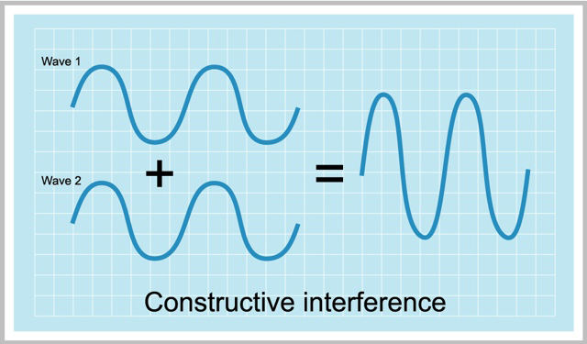
Two waves with the same frequency and phase.
Constructive Interference: add up the amplitudes

Slide 5
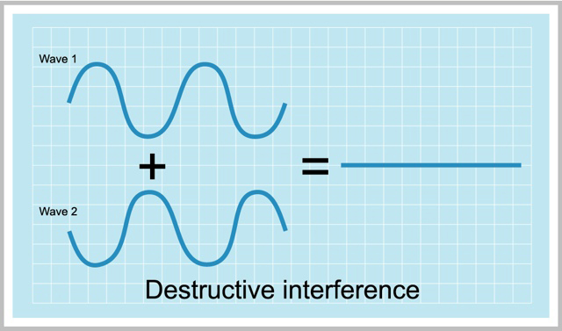
Two waves with same frequency and opposite phase.
Destructive Interference: subtract the amplitudes

Slide 7
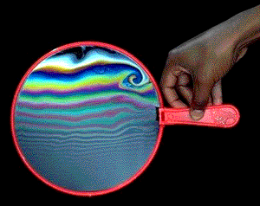
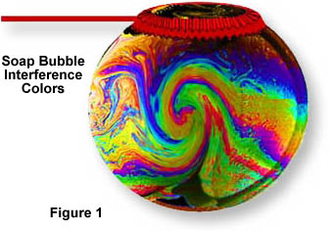
Bubbles!!!

Slide 8
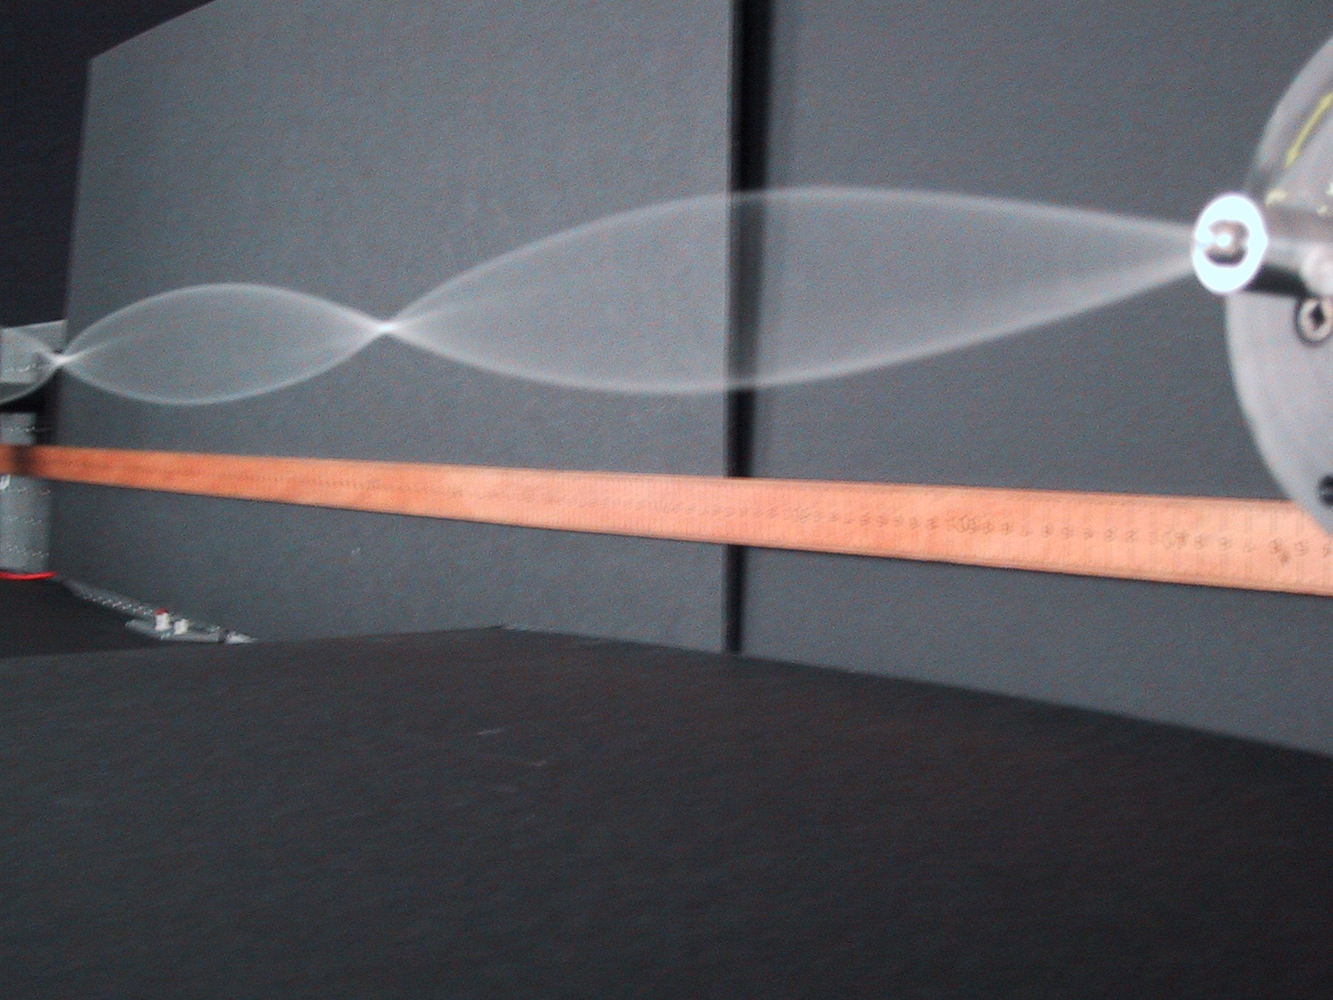
Standing waves

Slide 9
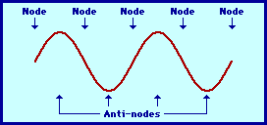
Standing waves are caused by constructive and destructive interference.
Areas of complete destructive interference have no amplitude and are called nodes.
Areas of complete constructive interference have large amplitudes and are called anti-nodes

Slide 10
When a wave strikes a fixed boundary it will reflect and invert its amplitude.
If a series of waves are sent along the string the reflected pulse will interfere with the next pulse.
If the waves are sent at just the right frequency we will create a standing wave.

Slide 11
Resonance is the tendency of an object to vibrate at maximum amplitude at certain frequencies.

