Slide 1
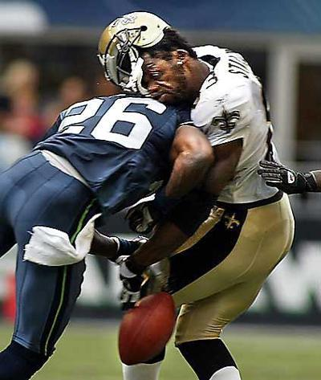
Collisions in 2D

Slide 2
When dealing with collisions in 2-dimensions it is important to remember that momentum is a vector with magnitude and direction.
When finding the total momentum, we have to do vector addition.

Slide 3
Collisions at 90º:
A 4.0 kg object is traveling south at a velocity of 2.8 m/s when it collides with a 6.0 kg object traveling at a velocity of 3.0 m/s east. If these two objects stick together upon collision, at what velocity do the combined masses move?
Before
After
1
2
1+2
m₁ = 4.0 kg m₂ = 6.0 kg m_{total} = _________
v₁ = 2.8 m/s v₂ = 3.0 m/s v_{total} = _________
p₁ = _______ p₂ = _______ p_{total} = _________

Slide 4
To find the total momentum, add the two initial vectors and find the resultant:
From the resultant momentum find the final velocity (magnitude and direction):
Remember that it is momentum that is conserved, so we need to add the momenta vectors NOT velocity!!!

Slide 5
Collisions not at 90º (because life is never that easy…):
A 4.0 kg bowling ball is moving east at an unknown velocity when it collides with a 6.1 kg frozen cantaloupe at rest. After the collision, the bowling ball is traveling at a velocity of 2.8 m/s 32º N of E and the cantaloupe is traveling at a velocity of 1.5 m/s 41º S of E. What was the initial velocity of the bowling ball?

Slide 6
There are two ways to solve this problem – the scalpel or the sledgehammer.
The scalpel a.k.a. Component Method (for the discerning physicist):
We need to break the final momenta of the two objects into x and y components:
p2_{x} =
p1
p1_{y} =
p2_{y} =
p2
p1_{x} =

Slide 7
We then add the individual x and the individually components to find our total momentum.
Σp_{x} = p_{1x} + p_{2x} =
Σp_{y} = p_{1y} + p_{2y} =
Notice that the total momentum is all in the x-direction! This should be no surprise since the bowling ball was initially only moving in the x-direction. Don’t forget to solve for the initial velocity (magnitude and direction):

Slide 8
The Sledgehammer aka Vector Addition (because hammers are fun):
To solve this problem we simply add the vectors and solve for c with the cosine law. Notice that the total momentum is either the initial or the final because momentum is conserved.
First we need to use geometry to solve for the angle opposite the total momentum.
And then, start hammering…
p1
p2
p_{total}

