Slide 1
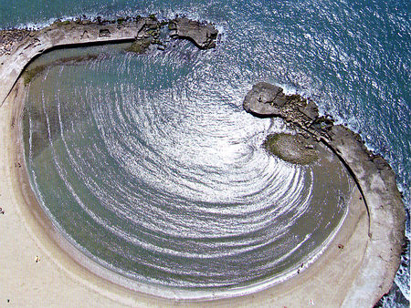
Diffraction

Slide 2
When waves in the ocean pass a barrier they bend around it

Slide 3
Waves passing through a narrow opening will spread in all directions

Slide 4
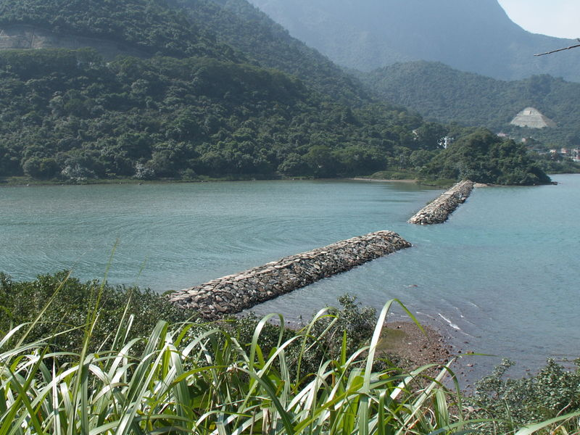

Slide 5
Diffraction: the bending of waves around the edges of barriers.
Diffraction can be affected by:
Wave speed: Greater speed = Less Bending
Wavelength: Longer λ = More Bending
Opening size: Smaller slit = More Bending

Slide 6
Now lets look at a wave passing through two side by side slits.

Slide 7
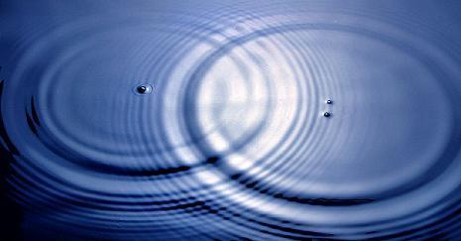

Slide 8
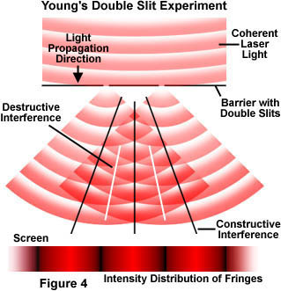
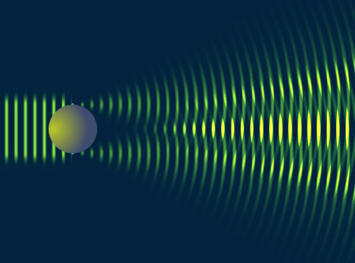
When two crests meet we see constructive interference and a maxima (bright spot)
When a crest meets a trough we see destructive interference and a minima (dark spot)

Slide 9
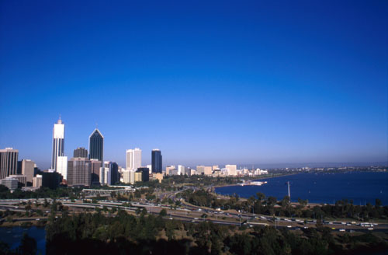
Why is the sky blue?
When a ray of light strikes a particle roughly the size of its wavelength it is scattered in all directions.
White light is scattered by particles in the air such as water.
Shorter wavelengths (blue) are scattered more than longer wavelengths (red).

Slide 10
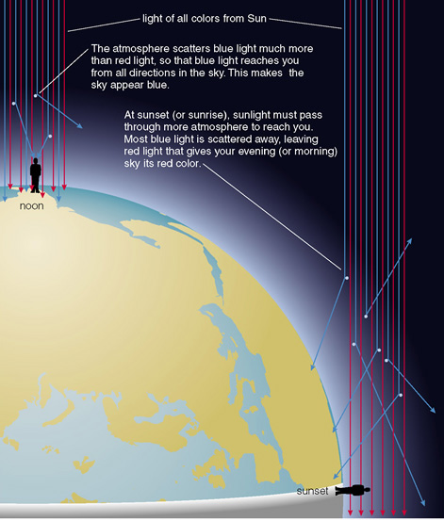
At sunset (or sunrise) the light has to pass through more of the atmosphere.
Much of the blue light is scattered away, leaving mostly red light.

Slide 11
