Slide 1
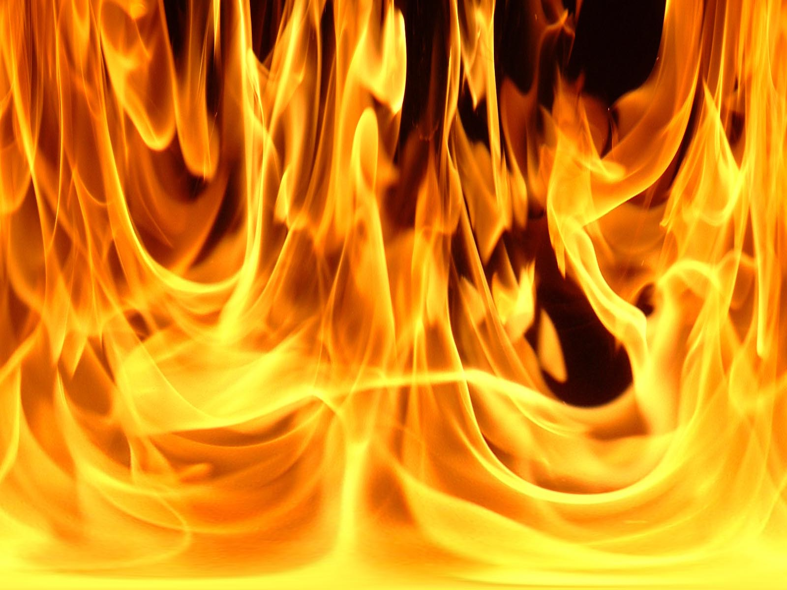
THERMAL ENERGY

Slide 2
Thermal energy vs. Temperature
Thermal Energy (Heat): total kinetic and stored energy within an object.
Temperature: The average kinetic energy of the particles within an object.

Slide 3
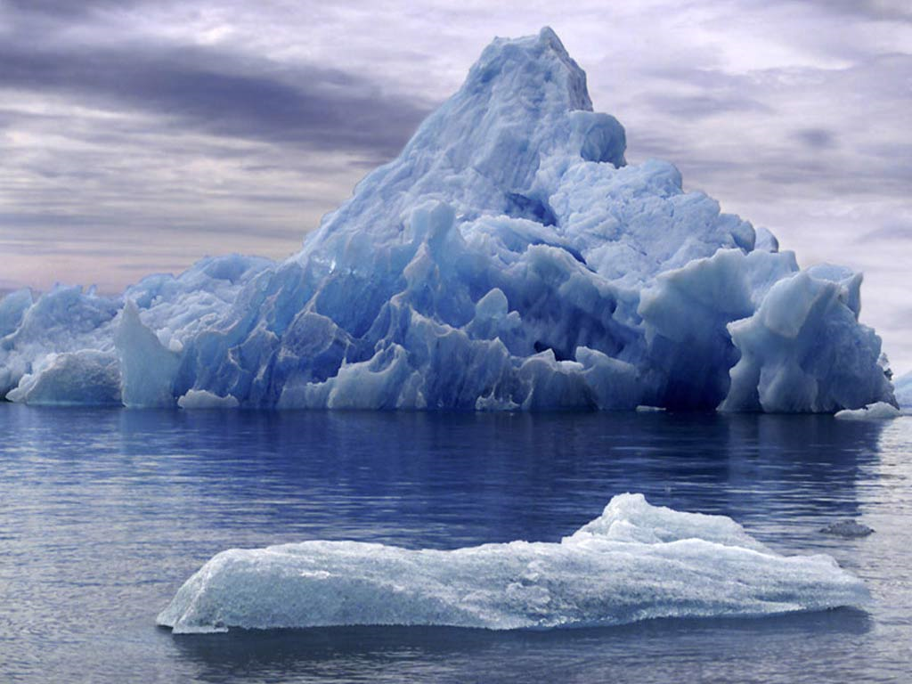
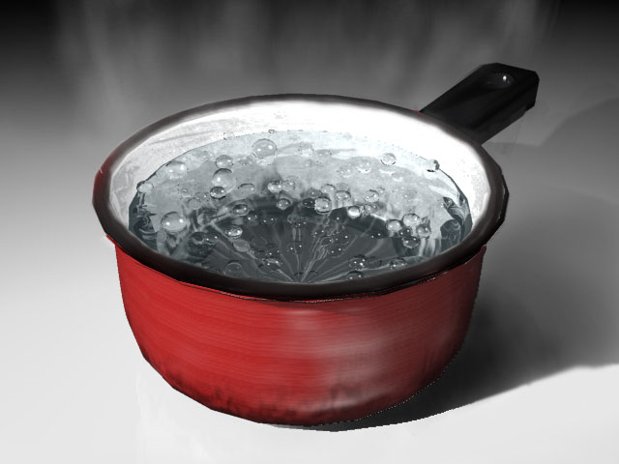
Example: Which contains more heat :
a pot of boiling water or an iceberg?

Slide 4
Atoms and molecules are in constant motion
When a material is heated the molecules move faster and as a result it will expand.

Slide 5
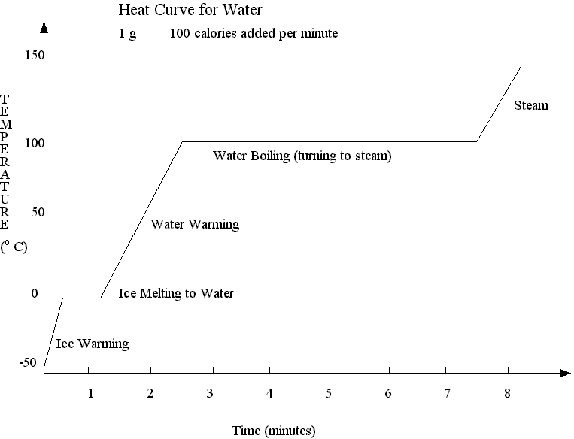
If an object is heated it will either:
1) Increase temperature 2) Change state

Slide 6
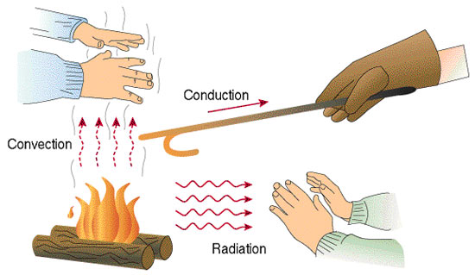
Heat will always flow from high to low concentration
1) Conduction
2) Convection
3) Radiation
Until thermal equilibrium is achieved

Slide 7
The amount of heat transferred is found with:
∆E_{H} = mc∆T
∆E_{H} = Change in thermal energy (Joules)
m = mass of object (kg)
c = specific heat capacity (J/kgºC)
∆T = change in temperature (ºC)

Slide 8
Some examples of SHC
Specific Heat Capacity
Water | 4180
Carbon | 720
Iron | 460
Copper | 390
Lead | 130

Slide 9
Example: Mr. Trask makes a cup of coffee by boiling 250 g of water that is initially at 15º C. How much heat is needed?

Slide 10
Example: A 35 kg child goes down a 3.2 m high slide. The child is initially at rest and moving at 1.8 m/s at the bottom of the slide. If the slide is made of 12 kg of iron and all heat is transferred into the slide, by how much does the temperature of the slide increase?

