Slide 1
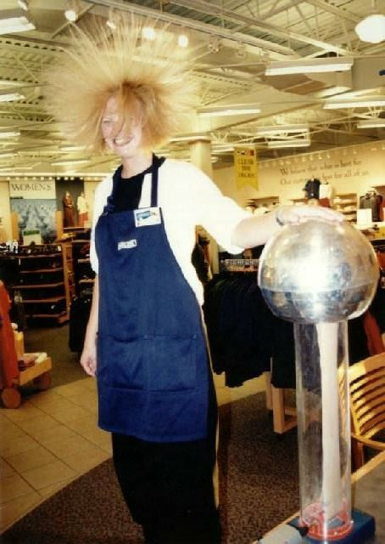
Coulomb’s Law

Slide 2
Matter is made of particles which are positively or negatively charged.
The unit of charge is the Coulomb (C)
Charges are conserved meaning that they cannot be created or destroyed. It is thought that the total charge of the entire universe is constant and neutral.

Slide 3
Charges are also quantized, meaning that they occur in finite packages.
The smallest unit of charge is called the elementary charge which is equal to the charge on one proton (+) or one electron (-).
Elementary Charge = 1.6 x 10⁻¹⁹ C

Slide 4
Coulomb determined that the force between two charged objects is proportional to their charges and inversely proportional to the square of their distances or:
Where: q₁ = 1st charge in Coulombs (C) q₂ = 2nd charge in Coulombs (C) r = distance between charges k = Coulomb’s Constant = 9.0x10⁹ Nm²/C²
F_{E} = kq₁q₂
r²

Slide 5
There are two important things to notice from this equation.
First, this equation is quite similar to Newton’s Law of Universal Gravitation:
F_{g} = Gm₁m₂
r²
Second, electrostatic forces are much stronger than gravitational forces. Notice the huge difference between G and k.

Slide 6
There is a very important fundamental difference between gravitational and electrostatic forces:
Gravity ALWAYS attracts objects,
Electrostatic forces can attract OR repel.
When solving for electrostatic force we will NOT use the + or – signs of the charges.
Instead we will determine the direction of the force based on the charges.

Slide 7
Example:
Two 85 kg students are 1.0 m apart. What is the gravitational force between them?
If these two students each have a charge of 2.0x10⁻³ C, what is the electrostatic force between them?

Slide 8
Example:
Two point charges of 1.8x10⁻⁶ C and 2.4x10⁻⁶ C produce a force of 2.2x10⁻³ N on each other. How far apart are these two charges?

Slide 9
Example: A charge of 1.7x10⁻⁶ C is placed 2.0x10⁻² m from a charge of 2.5x10⁻⁶ C and 3.5x10⁻² m from a charge of -2.0x10⁻⁶ as shown.
What is the net electric force on the 1.7x10⁻⁶ charge?
1.7x10⁻⁶ C
2.5x10⁻⁶ C
-2.0x10⁻⁶ C
2.0x10⁻² m
3.5x10⁻² m

