Slide 1
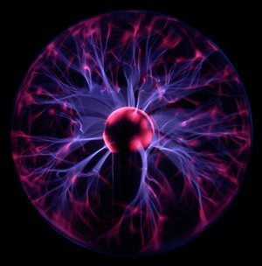
Electric Field

Slide 2
There are many similarities between gravitational and electrostatic forces. One such similarity is that both forces can be exerted on objects that are not in contact.
In the same way that any mass is surrounded by a gravitational field, we will imagine that any charge object is surrounded by an electric field.
Similar to gravitational fields, an electric field will depend on: the size of and distance to the charge.

Slide 3
In fact we define an electric field as the force per unit charge:
Where: E = electric field strength
F_{E} = electrostatic force
q = charge on the test object
E = F_{E} q

Slide 4
We can substitute in Coulomb’s Law to get:
Again note the similarity to gravitational field.
E = kq₁ r²

Slide 5
In the case of electric fields we are dealing with another example of a force field.
Therefore the field is a vector quantity.
In order to show this we always draw the field lines as arrows.

Slide 6
There is an important difference between gravitational fields and electric fields due to the fact that electric forces can be attractive or repulsive.
We therefore define the direction of an electric field as the direction a positive charge would move in that field.

Slide 7
You will remember that the strength of a vector field is indicated by the density of the arrows, therefore the field is always strongest where the density of the arrows is the greatest.

Slide 9
Example:
What is the electric field strength at a point where a -2.00 uC charge experiences an electric force of 5.30x10⁻⁴ N?

Slide 10
Example:
At a distance of 7.50x10⁻¹ m from a small charged object the electric field strength is 2.10x10⁴ N/C. At what distance from this same object would the electric field strength be 4.20x10⁴ N/C?

