Slide 1
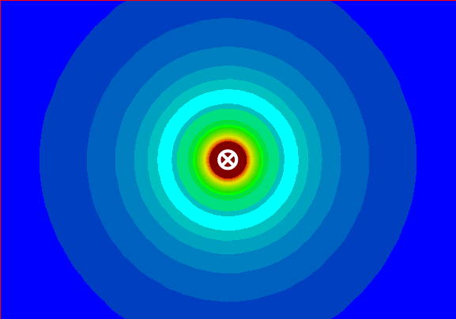
Magnetic Forces on Wires and Charges

Slide 2
With permanent magnets opposite poles attract and like poles repel.
As we have seen magnetic fields surround any current carrying wire.
Therefore it stands to reason that magnetic forces will act on wires carrying electric current and charged particles moving in a magnetic field.

Slide 3
Parallel Current Carrying Wires
Picture two parallel wires carrying current in the same direction, would the fields produced by these wires attract or repel?
Parallel wires with current flowing in the same direction will attract each other.

Slide 4
The same logic can be used to determine how parallel wires containing currents the flow in the opposite direction interact.
Parallel wires with current flowing in the opposite directions will repel.

Slide 5
Current Carrying Wires in Magnetic Fields
A current carrying wire in a magnetic field will also experience a force.
Imagine a current carrying wire placed between two permanent magnets.
S N
X
S N

Slide 6
Note that above the wire both the permanent magnetic field and the field generated by the wire point in the same direction
These two fields will repel.
Also, below the wire the permanent magnetic field and the field generated by the wire point in opposite directions.
These two fields will attract.

Slide 7
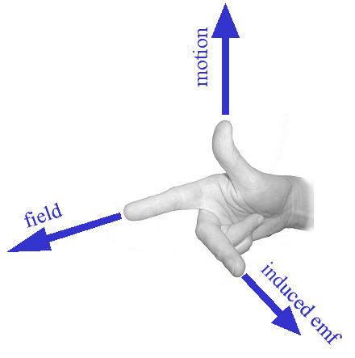
The 3rd Right Hand Rule:
Thumb: Particle Motion/ Current
Index Finger: Magnetic Field
Palm: Force

Slide 8
The magnitude of the magnetic force on a conductor can be calculated as:
Where: B =
I =
l =
θ =
F = BIlsinƟ

Slide 9
Note that if the conductor is perpendicular to the magnetic field this formula becomes:
F = BIl
Because
sin(90º) = 1
If the conductor is parallel to the magnetic field then there is no magnetic force acting on it.

Slide 10
Moving Charges in Magnetic Fields
In the same way that charged particles moving through a wire will experience a force in a magnetic field, so will free charged particles.
To determine the direction of the force on such a particle we simply use the RHR.

Slide 11
Moving Charges in Magnetic Fields
NOTE:
We use the right hand rules for wires when talking about conventional current
And the left hand rules for wires when talking about electron flow.

Slide 12
Moving Charges in Magnetic Fields
We follow the same logic when dealing with charged particles:
For positive particles use RHR
For negative particles use LHR

Slide 13
NOTE: Just like the magnetic force on conductors this formula can be reduced to
when the particles are moving perpendicular to the magnetic field.
To calculate the magnetic force on the particle we use:
Where: q =
v =
B =
θ =
F = qvBsinƟ
F = qvB

Slide 14
If a charged particle enters a magnetic field traveling perpendicular to the field, it will deflect continuously and travel in a circle. Consider an electron moving through a magnetic field
X X X X X X X X
X X X X X X X X
X X X X X X X X
X X X X X X X X
X X X X X X X X

Slide 15
Now consider a proton moving through the same magnetic field
X X X X X X X X
X X X X X X X X
X X X X X X X X
X X X X X X X X
X X X X X X X X

