Slide 1
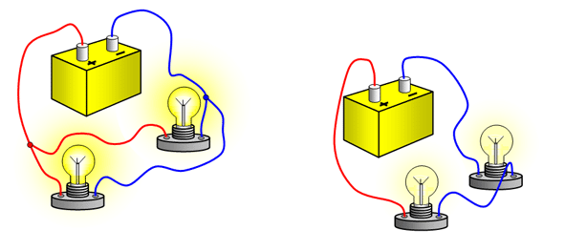
Resistors in Series and Parallel

Slide 2
An electrical circuit requires a voltage source and a complete circuit. Electrical devices can be placed in the circuit so that the current flows through them.
In any circuit there is some resistance. The resistance of a circuit works like friction, slowing down current and generating heat.
To draw the various devices that can make up electric circuits, we use schematic diagrams that are blueprints of a circuit.

Slide 3
Schematic | Name | Function

Slide 4
There are two ways that we can attach devices to a circuit.
Series: only one path for current to flow
Ex. Draw a battery of two cells connected to two resistors in series.

Slide 5
In series circuits the current must flow through each device.
If one device in a series circuit burns current cannot flow and no devices receive current.
Adding devices in series increases total resistance.

Slide 6
Parallel: multiple pathways for current to flow
Ex. Draw a battery of two cells connected to two resistors in parallel.

Slide 7
In a parallel circuit current will flow through each pathway.
If one device in a parallel circuit burns out the others will still receive current.
Adding devices in parallel decreases total resistance.

Slide 8
Measuring Voltage and Current
We can measure the voltage in a circuit using a voltmeter and the current in a circuit using a ammeter.
We need to connect these two devices in different ways.

Slide 9
A voltmeter must be connected in parallel. This is because a voltmeter measures the voltage drop across a device.
Ex.

Slide 10
An ammeter must be connected in series. This is because an ammeter measures the current through a circuit.
Ex.

Slide 11
One last note…
There are two types of current. DC (direct current) means it flows in one direction such as the current from a battery.
AC (alternating current) means that it alternates the direction of flow. In the case of home electric circuits, they alternate at 60 Hz.
As fun as it sounds AC is a little advanced for us just yet so we sill be mostly sticking to DC in this course.

