Slide 1
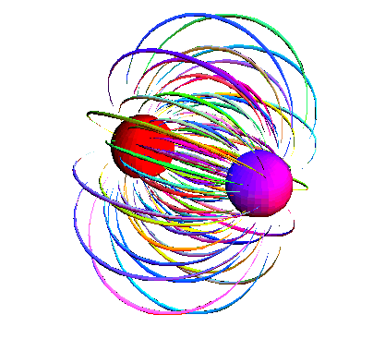
Electric Fields From Multiple Point Charges

Slide 2
We have already seen how charged particles emit electric fields, but how do these fields interact when two or more charges act on each other?
Consider two positively charged particles:
Note that the electric lines of force work against each other.

Slide 3
Because this electric field is a force field, it is a vector. So when multiple fields overlap we simply add the vectors.
OK, now try two opposite charges:
Again the two fields interact, only this time they work in the same direction.

Slide 4
Example:
What is the strength of an electric field midway between a 2.00 uC charge and a -4.00 uC that are 0.60 m apart?

Slide 5
Example:
Two 5.25 uC charges are 0.40 m apart. What is the strength of the electric field between them at a point 0.10 m away from the first charge and 0.30 m away from the second?

Slide 6
Example:
Find the magnitude and direction of the electric field at the point P due to the charges as shown.
12.0 uC
6.0 m
- 8.0 uC
4.5 m

