Slide 1
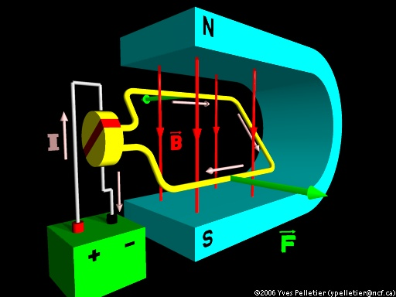
Motors and Galvanometers

Slide 2
Motors
We have seen that a current carrying wire perpendicular to a magnetic field will experience a force.
This phenomenon is used by an electric motor to transform electrical energy into mechanical energy.
A simple DC motor consists of a loop of wire that passes through a magnetic field. The ends of the loop are attached to a split ring commutator which turns with the loop. Fixed brushes connect the commutator to the voltage source.

Slide 3
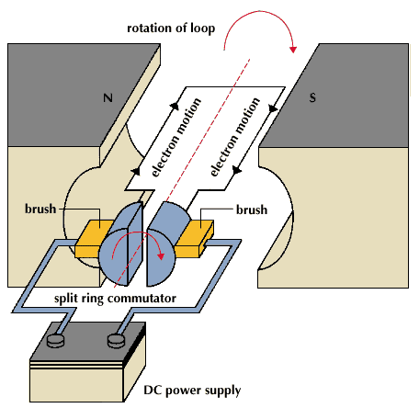
The commutator (split ring) is important because…
…it reverses the direction of current every half turn.

Slide 4
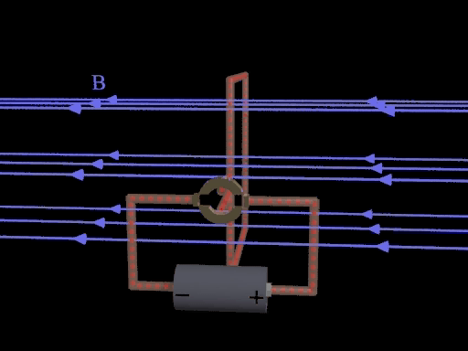

Slide 5
Galvanometers
A galvanometer is an instrument used to detect electric current. A galvanometer calibrated to measure current is called an ammeter while one that measures voltage is called a voltmeter.
These devices also make use of the motor principle.

Slide 6
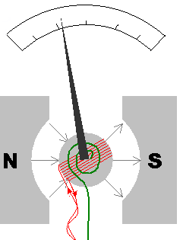
Essentially, a current carrying wire in a magnetic field will experience a force proportional to the current.
As shown, when a current flows through the wire the needle will experience a force. The needle is attached to a spring which provides a restorative force. As the coil rotates against the spring a reading is produced

Slide 7
A galvanometer can be converted into an ammeter by placing a shunt (wire) of low resistance parallel to the coil. In other words a parallel path for electrons so that only a small fraction of electrons flow through the coil.
A galvanometer can be converted into a voltmeter by placing a shunt (wire) of high resistance in series with the coil. This greatly reduces the current that flows through the meter.

