Slide 1
Cathode Ray Tubes and The JJ Thompson Experiment

Slide 2
Consider the following example:
1) The electron beam is produced by accelerating electrons through an electric potential difference of 380 V. What is the speed of the electrons as they leave the 380 V plate?
2) What is the electrostatic force on electrons in the region between the horizontal plates when they are connected to a 9.0 V potential difference?
3) What is the acceleration of the electrons in the beam?

Slide 3
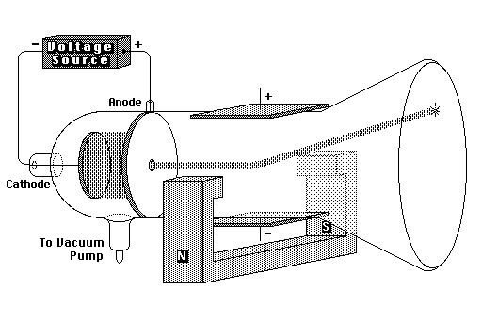
Famed physicist J.J. Thompson took the cathode ray a step further. First he set up a cathode ray tube that deflected the electron ray using a second set of electrically charged plates (aka yoke), similar to the example above.
As expected the ray deflected towards the positive plate.

Slide 4
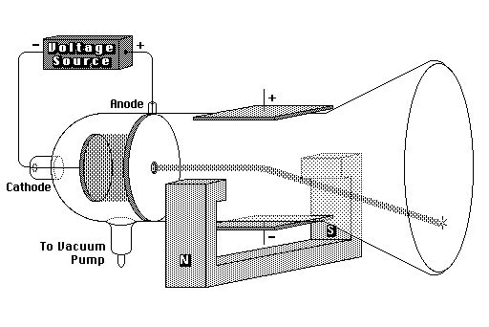
He then disconnected the current from the electric yoke and instead sent current through an electromagnet flanking the cathode ray. He was intrigued to note that the ray of electrons deflected downwards

Slide 5
It stands to reason that these electrons are being accelerated in a circular path by a magnetic force. Of course any force that works to accelerate an object in a circular path is known as centripetal.
In this case:

Slide 6
Since r and B can both be easily measured we could simply determine the speed of the electron using the Law of Conservation of Energy.
Unfortunately for good old J. J., nobody knew the mass or charge of an electron. Both of which would be needed to determine the velocity of the electron ray.
But then, he weren’t no genius for nothin’. He set up another cathode ray that had both electromagnetic and electrostatic yokes working in opposition to each other.

Slide 7
By gently calibrating the electric field between the plates, he was able to obtain an undeflected beam as shown:

Slide 8
In this case where the electrons are undeflected, we know that the electrostatic and magnetic forces are balanced and therefore equal.
Or simply,
This can be used to solve for the velocity of the electrons,
which in turn allowed Thompson to determine the charge to mass ratio of the electron long before either quantities were understood.
F_{E} = F_{M}
v = E B

Slide 9
Example:
Charged particles traveling horizontally at 3.60x10⁶ m/s when they enter a vertical magnetic field of 0.710 T. If the radius of their arc is 9.50x10⁻² m, what is the charge to mass ratio of the particles?

Slide 10
Example:
What is the speed of an electron that passes through an electric field of 6.30x10³ N/C and a magnetic field of 7.11x10⁻³ T undeflected? Assume the electric and magnetic fields are perpendicular to each other.

Slide 11
Example:
An electron traveling vertically enters a horizontal magnetic field of 7.20x10⁻² T. If the electron is deflected in an arc of radius 3.70x10⁻³ m, what is the kinetic energy of the electron?

