Slide 1
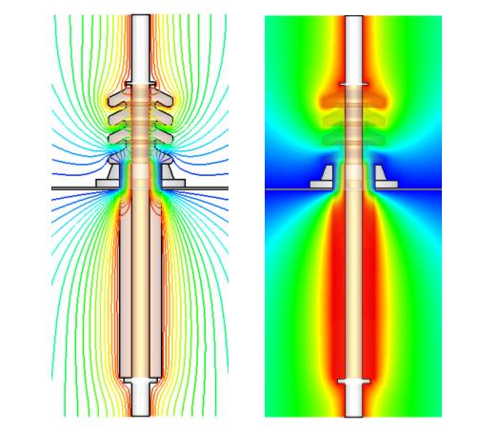
Electric Potential and Electric Potential Energy
Somehow Different!!

Slide 2
First let’s examine electric potential energy. If a charged object is in an electric field it has electric potential energy - that is it has the potential to move in that field. Note that the potential energy it has could be used to move towards or away from the charge.
A non-uniform field, such as that provided by a point, is one which has different magnitude and direction depending on proximity to the charge.
Again note the similarities…

Slide 3
In this case we can derive a formula for the electric potential energy in a NON-UNIFORM FIELD:
Again note the similarities between gravitational and electric potential energy.
Again note the similarities…

Slide 4
Example:
How much work must be done to bring a 4.0 uC charged object to within 1.0 m of a 6.0 uC charged object from a long way away?

Slide 5
NOTE:
Potential energy is a scalar quantities and so we do not do vector addition.
We WILL use + and – signs when calculating potential energy.
In this case, bringing a positive charge near another positive charge requires energy therefore work is positive.

Slide 6
Example:
How much work must be done to bring a -7.0 uC charged object to within 0.5 m of a 5.0 uC charged object from a long way away?
In this case, bringing a negative charge near a positive charge releases energy therefore work is negative.

Slide 7
Example:
A 4.0 x10⁻⁹ C charge of mass 2.4 x10⁻²¹ kg, is initially located at point A, 3.0 m from a stationary 6.0x10⁻⁸ C charge.
a) How much work is required, by an external agent, to move the 4.0x10⁻⁹ C charge to a point B, 0.50 m from the stationary charge?

Slide 8
b) If the 4.0x10⁻⁹ C charge is now released from point B, what will be its velocity when it passes back through point A?

Slide 9
Electric Potential
Now we need to consider a new quantity, electric potential (V). Electric potential is defined as the electric potential energy per unit charge.
Which becomes,
NOTE:
The electric potential is defined in terms of the moving of a positive charge. Therefore…
The unit for potential is…

Slide 10
NOTE:
The electric potential is defined in terms of the moving of a positive charge. Therefore:
+ charges move towards areas of low potential.
- charges move towards areas of high potential.
2. The unit for potential is J/C or Volts (V)

Slide 11
Example:
Calculate the potential at point P as shown in the diagram.
3.0 uC
5.0 cm
P
1
40º
50º
5.0 cm
7.0 cm
2
3
4.0 uC
-2.0 uC
NOTE:
Potentials are scalar quantities and so we do not do vector addition.
We WILL use + and – signs when calculating potentials

Slide 12
Potential Difference
We sometimes want to determine the electric potential between two points. This is known as the potential difference.
For example, given two points A and B, the potential difference between A and B is:
NOTE: When we talk about potential at a point we are talking about the potential difference between that point and infinity, where the potential at infinity is ZERO.

Slide 13
Ex.
What is the potential difference between points A and B due to the charge shown?
A
B
0.50 m
1.00 m
8.00 uC

