Slide 1
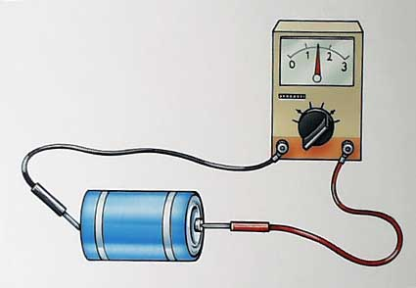
Electromotive force

Slide 2
We know that a battery is a source of potential difference (voltage) or electric energy. When not connected to a circuit there is a potential difference between the terminals.
This voltage is also known as…
electro-motive force (EMF)
Despite the name, this is a potential not a force.
This dates back to a time when we thought that the two were equivalent.

Slide 3
For example a car battery has an EMF of 12 V and lithium battery has an EMF of 1.5 V.
However, as soon as a battery is connected to a circuit and current flows through it the potential difference across the terminals is always less than the total EMF.
This is due to the fact that every battery has internal resistance.

Slide 4
Because of this internal resistance the terminal voltage is always less than the EMF of the battery.
Where:
ε = EMF
V = terminal voltage
I = Current
r = internal resistance
Note: Ir = the internal voltage drop
Note: If the battery is not connected to a circuit there is no current and therefore no internal voltage drop.
V_{term} = ε - Ir

Slide 5
Consider the following diagram showing a circuit with an external resistance (R) internal resistance (r) and EMF (ε).
When a battery goes dead it is because the internal voltage drop matches the EMF.

Slide 6
Example:
If a 12.0 V battery has an internal resistance of 0.220 ohms, what is the terminal voltage of the battery when a current of 3.00 A flows through the battery?

Slide 7
When a rechargeable battery is being charged an external voltage is applied to the battery. In order to force electrons backwards into the battery the external voltage must be greater than the EMF of the cell.
In fact the external voltage must be:
V_{term} = ε + Ir

Slide 8
Example:
A 12.0 V car battery is being charged by an alternator that can supply 15 V. If the internal resistance of the battery is 1.3 ohms, what is the current through the battery?

