Slide 1
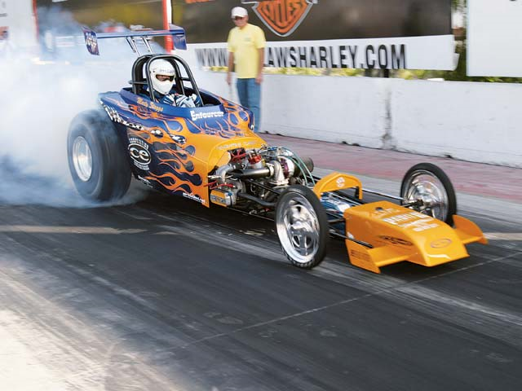
Force of Friction

Slide 2
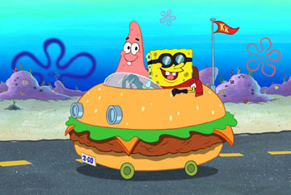
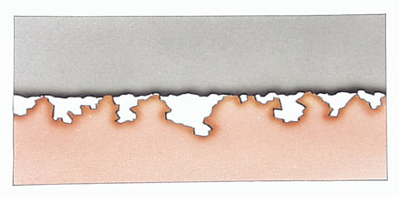
Friction is created whenever two surfaces try to move past one another.
On the microscopic level, irregularities in each surface impede motion, therefore the smoother the surface the less friction.

Slide 3
F_{f} is given by the equation:
Where: F_{N} = Normal (supporting) force
= ALWAYS perpendicular to surface
μ = Coefficient of friction, no units
= Greek letter “myu”
= depends on BOTH surfaces
F_{f} = μF_{N}

Slide 4
There are two types of friction:
Static Friction: The friction force that must be overcome in order to initially move an object.
Kinetic Friction: The friction force that occurs on an object that is in motion.
Generally:
Friction_{static} > Friction_{kinetic}
μ_{s} > μ_{k}

Slide 5
Ex 1
A 3.75 kg block is pushed along a tabletop with a force of 45.0N. The coefficient of friction is 0.65.
a) Find the force of friction.
b) Find the acceleration.

Slide 6
Ex 2
A 0.200 kg puck is pushed along a sheet of ice with a force of 0.240 N. If it moves at a constant velocity, find the coefficient of friction.

Slide 7
Ex 3
A 1.1 kg textbook is held against a vertical wall with a force of 45 N. What is the coefficient of friction between the book and the wall?

