Slide 1
Moving Conductors in Magnetic Fields

Slide 2
We have already seen that a loop rotating in a magnetic field will generate an EMF according to Faraday’s Law (ε = -NΔФ/Δt )
However when considering a conductor moving in a magnetic field it is better to consider a different form of this equation.
For Moving Conductors:
Where:
ε = Induced EMF
B = Magnetic Field
l = length of conductor
v = velocity of conductor
ε = Blv

Slide 3
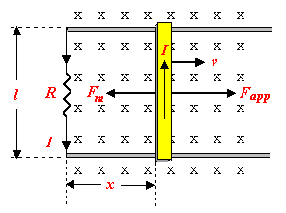
Derivation

Slide 4
Example:
A conducting rod 25.0 cm long moves perpendicular to a magnetic field (B = 0.20 T) at a speed of 1.0 m/s. Calculate the induced EMF in the rod.

Slide 5
Example:
A conducting rod 15 cm long moves at a speed of 2.0 m/s perpendicular to a 0.30 T magnetic field. If the resistance of the circuit is 4.0 ohms, what is the magnitude of the current through the circuit?

Slide 6
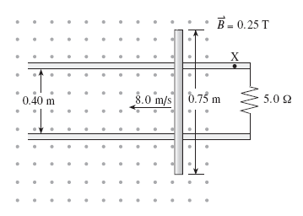
Example:
A 0.75 m conducting rod is moved at 8.0 m s across a 0.25 T magnetic field along metal rails. The electrical resistance of the system is 5.0 Ω.
What are the
magnitude and
direction of the
current through
point X?

