Slide 1
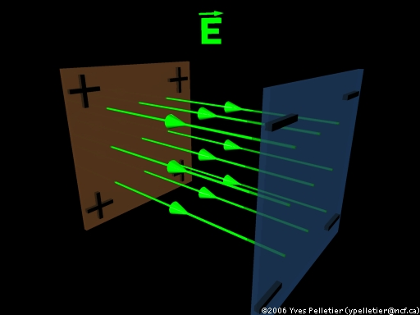
Electric Potential Between Charged Plates

Slide 2
We have seen that the electric field surrounding a point charge is not uniform – that it varies depending on distance to the source.
If we examine the electric field between charged plates we will find that it is uniform or constant.
Notice that the density of the lines is also uniform.

Slide 3
In a uniform electric field we cannot use our previous formula:
This formula is only valid for describing the strength of non-uniform fields (point charges only!!!)

Slide 4
To find an equation for uniform fields, we will once again draw a parallel with gravitational potential energy.
Consider a mass sitting in a uniform gravitational field at some height.
The mass will tend to move from an area of high potential energy to an area of low potential energy.
As it does it gains kinetic energy.

Slide 5
If we allow the mass to fall the work done on it (W = Fd) is negative. If we want to lift the mass to a certain height we need to do positive work on it.
A charged object in an electric field will behave in the same way, accelerating from an area of high E_{p} to low E_{p}.
As it does it gains E_{k}.

Slide 6
In the same way that we would do positive work on an object to lift it against gravity, we need to do work to bring a positive charge near a plate with positive potential.
To calculate the work done in this case we can use the formula:
W = Δ E_{p} = Fd

Slide 7
It is often easier, however, to describe the work done in a uniform field using the potential difference between the two plates.
Recall that potential difference:
∆V = ΔEp q
A potential difference is generated any time we have areas of high and low potential energy, just like those generated by gravitational fields.

Slide 8
In order to determine the electric field between two charged plates we must use the formula:
Where: E = Electric field strength
ΔV = Potential difference
d = distance between plates
E = ΔV d

Slide 9
Example:
Calculate the electric field strength between two parallel plates that are 6.00x10⁻² m apart. The potential of the top plate is 6.0 V and the bottom plate is -6.0 V.

Slide 10
Example:
An electron is accelerated from rest through a potential difference of 3.00x10⁴ V. What is the kinetic energy gained by the electron?

Slide 11
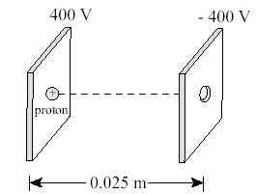
Example:
A proton, initially at rest, is released between two parallel plates as shown.
What is the magnitude and direction of the electric field?
b) What is the magnitude of the electrostatic force acting on the proton?
c) What is the velocity of the proton when it exits the - 400 V plate?

