Slide 1
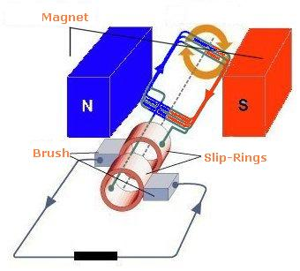
Back EMF

Slide 2
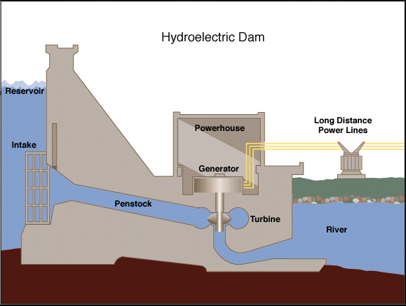
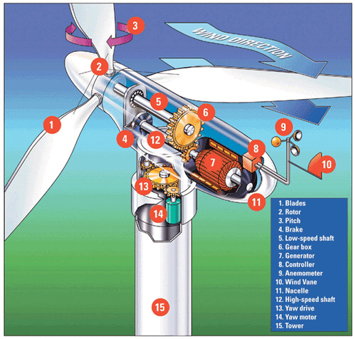
Devices that use mechanical energy to induce an electric current are called generators. Many kinds of mechanical energy can therefore by converted into electrical energy such as in: hydro-electric and wind turbines.

Slide 3
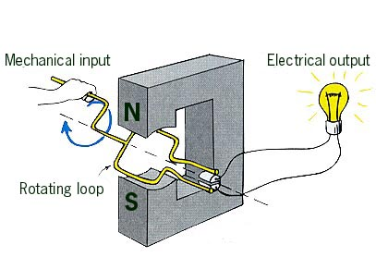
Note that this works in the exact opposite manner as an electric motor.
Motor: electrical energy to mechanical energy
Generator: mechanical energy to electrical energy
Notice that these generators produce alternating current because the direction of the current reverses every half turn.
Remember that to determine the direction of the current through a loop we can use right hand rules and to determine the EMF produced by a loop we can use ε = NΔФ/t.

Slide 4
This brings up an inherent problem with all electric motors.
As we said, electric motors are basically coils of wire rotating in a magnetic field.
However, we know that whenever we rotate wires in a magnetic field we generate an electric potential.
We also know from Lenz’s Law that the induced EMF works in the opposite direction.

Slide 5
This is called Back EMF
And it always works against the applied EMF.
Back EMF can be calculated using:
Where: V_{back} = induced back EMF
ε = EMF of voltage source
I = current through motor
r = resistance of armature
V_{Back} = ε - Ir

Slide 6
Example:
A 120 V motor draws 12 A when operating at full speed. The armature has a resistance of 6.0 ohms.
a) Find the current when the motor is initially turned on.
b) Find the back EMF when the motor reaches full speed.

Slide 7
Example:
The diagram shows a 0.010 kg metal rod resting on two long horizontal frictionless rails which remain 0.40 m apart. The circuit has a resistance of 3.0 Ω and is located in a uniform 0.20 T magnetic field.
a) What is the initial acceleration of the bar?
b) What is the value of the terminal velocity as limited by the back emf produced by the moving glider?

Slide 8
Example:
The diagram below shows a pair of horizontal parallel rails 0.12 m apart with a uniform magnetic field of 0.055 T directed vertically downward between the rails. There is a glider of mass 9.5x10⁻² kg across the rails. The internal resistance of the 75 V power supply is 0.30 ohms and the electrical resistance of the rails and the glider is negligible. Assume friction is also negligible.
a) What is the initial acceleration of the bar?
b) What is its top speed?

