Slide 1
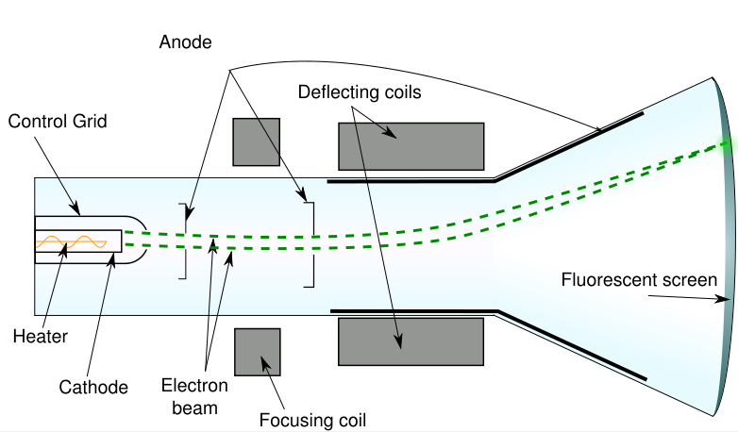
Cathode Ray Tubes

Slide 2
Non-flat screen TVs and monitors work by directing a beam of high speed particles at a film of fluorescing chemicals.
These charged particles are accelerated by electrically charged plates.
After they are sped up, the beam can be directed by very precise control of another set of charged plates.

Slide 3
Consider the following problem:
A beam of electrons is directed to a region between oppositely charged parallel plates as shown in the diagram below.

Slide 4
1) The electron beam is produced by accelerating electrons through an electric potential difference of 380 V. What is the speed of the electrons as they leave the 380 V plate?

Slide 5
2) What is the electrostatic force on electrons in the region between the horizontal plates when they are connected to a 9.0 V potential difference?

Slide 6
3) What is the acceleration of the electrons in the beam?

Slide 7
4) What is the final magnitude and direction of the velocity of the electrons as it leaves the second set of plates?

Slide 8
5) How could you cause the beam to bend…
a. more?
i)
ii)
b. less?
i)
ii)

