Slide 2
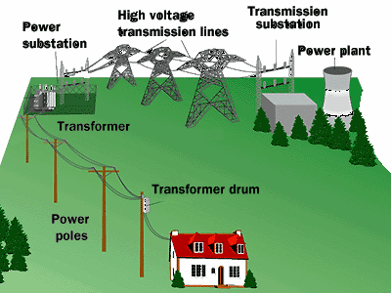
When we generate power we ramp up the voltage for transmission (up to 100 000V) and then when it arrives at homes we ramp it back down for convenient use (120V).
Say we need to transmit a certain amount of power (P = IV)
a high voltage means a low current.
since power lost by the wire due to resistance is P_{loss} = I²R
low current means power loss is at a minimum

Slide 3
But how is this done?
To convert voltage to a higher or lower value we use a transformer.
This is another important application of electromagnetic induction.

Slide 4
A transformer consists of a primary coil and a secondary coil.
As current flows through the primary coil it produces a magnetic field. This magnetic field then induces an electric current in the secondary coil.
Note that transformers generally only work when using alternating current. If we use direct current then we need to constantly switch the current on and off.

Slide 5
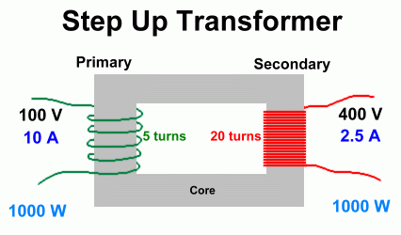
When a transformer increases voltage it is called a step-up transformer
Note that a step up transformer has…
…more secondary coils than primary.

Slide 6
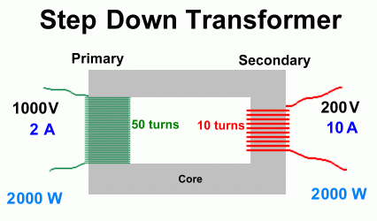
When a transformer decreases voltage it is called a step-down transformer
Note that a step up transformer has…
…more primary coils than secondary.

Slide 7
To determine the voltage change we use the following:
V_{s} = N_{s}
V_{p} N_{p}
Where: V_{p} = primary V
V_{s} = secondary V
N_{p} = # of turns on primary coil
N_{s} = # of turns on secondary coil

Slide 8
Although we may change the voltage, we must conserve energy.
Therefore, power must also be conserved. So,
V_{s} I_{p}
V_{p} I_{s}

Slide 9
Example
A step transformer is used to convert 120 V to 1.50x10⁴ V. If the primary coil has 24 turns, how many turns does the secondary coil have?

Slide 10
Example
A step-up transformer has 1000 turns on its primary coil and 1x10⁵ turns on its secondary coil. If the transformer is connected to a 120 V power line, what is the step-up voltage?

Slide 11
Example
A step-down transformer reduces the voltage from a 120 V to 12.0 V. If the primary coil has 500 turns and draws 3.00x10⁻² A,
a) What is the power delivered to the secondary coil?
b) What is the current in the secondary coil?

